Slide 1


P
Preparation for Calculus
Copyright © Cengage Learning. All rights reserved.

Slide 2

P.4
Inverse Functions
Copyright © Cengage Learning. All rights reserved.

Slide 3
Objectives
Verify that one function is the inverse function of another function.
Determine whether a function has an inverse function.
Develop properties of the six inverse trigonometric functions.

Slide 4
Inverse Functions

Slide 5
Inverse Functions
Recall that a function can be represented by a set of ordered pairs. For instance, the function f (x) = x + 3 from
A = {1, 2, 3, 4} to B = {4, 5, 6, 7} can be written as
f : {(1, 4), (2, 5), (3, 6), (4, 7)}.
By interchanging the first and second coordinates of each ordered pair, you can form the inverse function of f. This function is denoted by f ^{–1}. It is a function from B to A, and can be written as
f ^{–1}: {(4, 1), (5, 2), (6, 3), (7, 4)}.

Slide 6
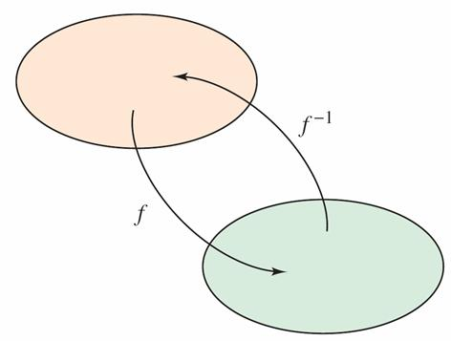
Inverse Functions
Note that the domain of f is equal to the range of f ^{–1}, and vice versa, as shown in Figure P.31.
The functions f and f ^{–1} have the effect of “undoing” each other.
Domain of f = range of f ^{–1}
Domain of f ^{–1} = range of f
Figure P.31

Slide 7
Inverse Functions
That is, when you form the composition of f with f ^{–1} or the composition of f ^{–1} with f, you obtain the identity function.
f (f ^{–1}(x)) = x and f ^{–1}(f (x)) = x

Slide 8
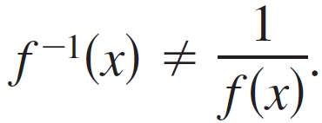
Inverse Functions
Connecting Notations:
Although the notation used to denote an inverse function resembles exponential notation, it is a different use of –1 as a superscript.
That is, in general,

Slide 9
Inverse Functions
Here are some important observations about inverse functions.
1. If g is the inverse function of f, then f is the inverse
function of g.
2. The domain of f ^{–1} is equal to the range of f, and the
range of f ^{–1} is equal to the domain of f.
3. A function need not have an inverse function, but when it
does, the inverse function is unique.
You can think of f ^{–1} as undoing what has been done by f .

Slide 10
Inverse Functions
For example, subtraction can be used to undo addition, and division can be used to undo multiplication. So,
f (x) = x + c and f ^{–1}(x) = x – c
are inverse functions of each other and
f (x) = cx and f ^{–1}(x) = c ≠ 0,
are inverse functions of each other.
Subtraction can be
used to undo addition.
Division can be used
to undo multiplication.

Slide 11
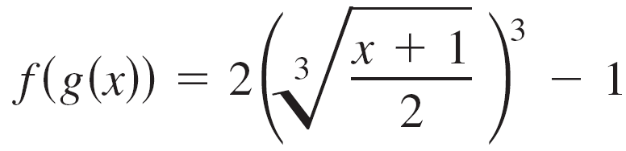
Example 1 – Verifying Inverse Functions
Show that the functions are inverse functions of each other.
f (x) = 2x³ – 1 and g(x) =
Algebraic Solution:
Because the domains and ranges of both f and g consist of all real numbers, you can conclude that both composite functions exist for all x.
The composition of f with g is

Slide 12
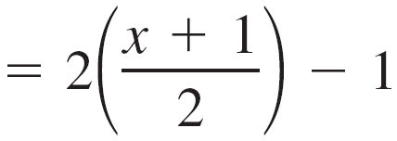
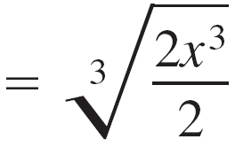

Example 1 – Solution
cont’d
The composition of g with f is
Because f (g(x)) = x and g(f (x)) = x, you can conclude that f and g are inverse functions of each other

Slide 13
Example 1 – Solution
cont’d
Numerical Solution:
Use a graphing utility to show that f and g are inverse functions of each other.
Enter y₁ = f (x), y₂ = g(x), y₃ = f (g(x)), and y₄ = g(f (x)).

Slide 14
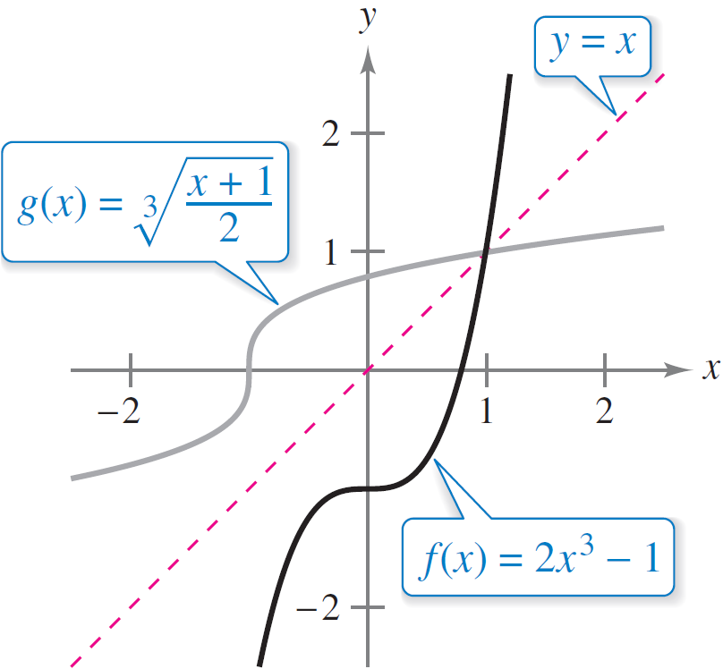
Example 1 – Solution
cont’d
Notice that the entries for x, y₃, and y₄ are the same. So, it appears that f (g(x)) = x and g(f (x)) = x, and that f and g are inverse functions of each other. (See Figure P.32.)
f and g are inverse functions of each other.
Figure P.32

Slide 15
Inverse Functions
In Figure P.32, the graphs of f and g = f ^{–1} appear to be mirror images of each other with respect to the line y = x.
The graph of f ^{–1} is a reflection of the graph of f in the line
y = x.
This idea is generalized as follows.

Slide 16
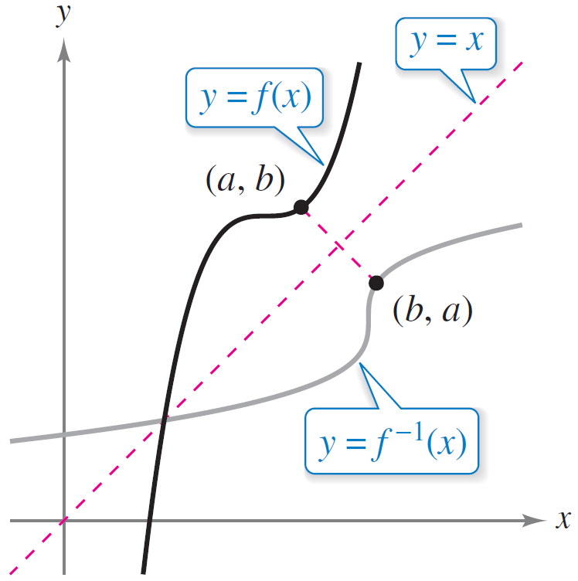
Inverse Functions
To see the validity of the Reflective Property of Inverse Functions, consider the point (a, b) on the graph of f.
This implies f (a) = b and you can write
f ^{–1}(b) = f ^{–1}(f (a)) = a.
So, (b, a) is on the graph of f ^{–1}, as
shown in Figure P.33. A similar
argument will verify this result in
the other direction.
The graph of f ^{–1} is a reflection of
the graph of f in the line y = x.
Figure P.33

Slide 17
Existence of an Inverse Function

Slide 18
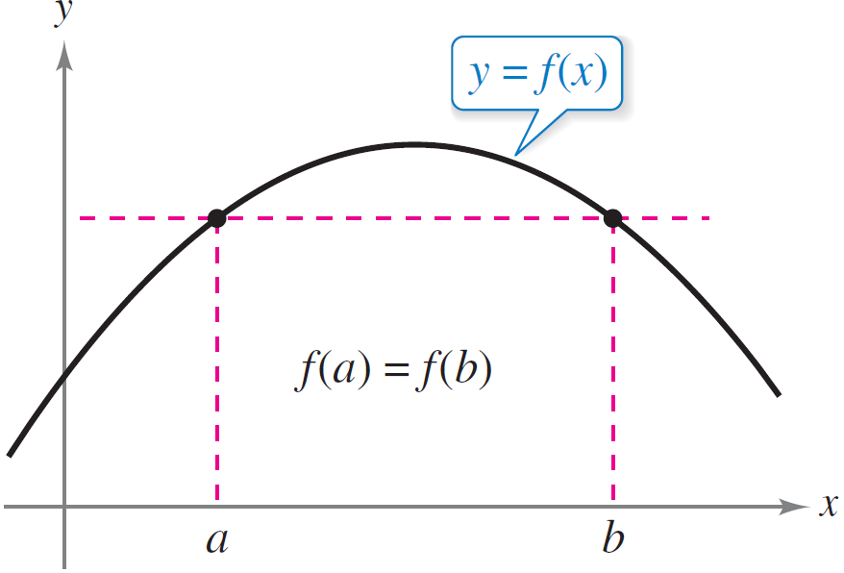
Existence of an Inverse Function
Not every function has an inverse, and the Reflective Property of Inverse Functions suggests a graphical test for those that do—the Horizontal Line Test for an inverse function.
This test states that a function f
has an inverse function if and
only if every horizontal line
intersects the graph of f at most
once (see Figure P.34).
If a horizontal line intersects the graph of f
twice, then f is not one-to-one.
Figure P.34

Slide 19
Existence of an Inverse Function
The following definition formally states why the Horizontal Line Test is valid.

Slide 20
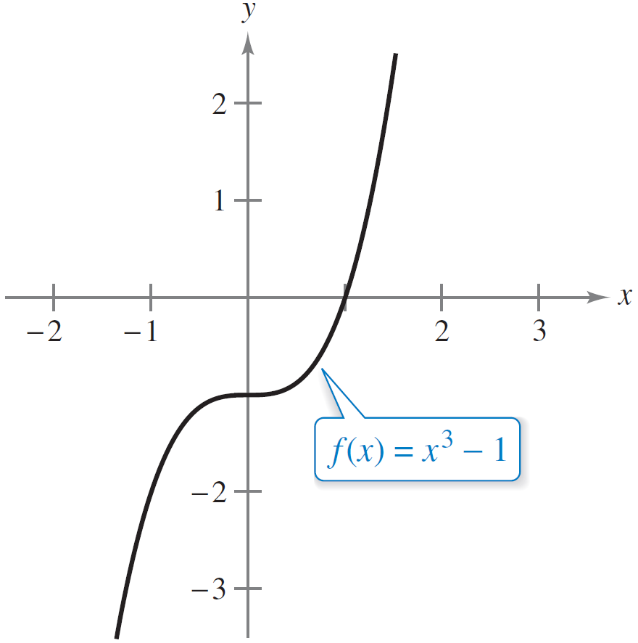
Example 2 – The Existence of an Inverse Function
Which of the functions has an inverse function?
a. f (x) = x³ – 1 b. f (x) = x³ – x + 1
Solution:
a. From the graph of f shown in
Figure P.35(a), it appears
that f is one-to-one over its
entire domain.
Because f is one-to-one over its entire
domain, it has an inverse function.
Figure P.35(a)

Slide 21

Example 2 – Solution
cont’d
To verify this, suppose that there exist x₁ and x₂ such
that f (x₁) = f (x₂). By showing that x₁ = x₂, it follows that f
is one-to-one.
f (x₁) = f (x₂)
x₁ = x₂
Because f is one-to-one, you can conclude that f must
have an inverse function.

Slide 22
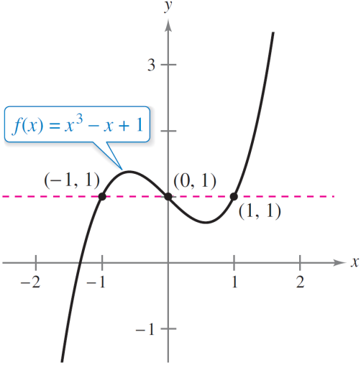
Example 2 – Solution
cont’d
b. From the graph of f shown in
Figure P.35(b), you can see
that the function does not
pass the Horizontal Line Test.
In other words, it is not
one-to-one.
For instance, f has the same value when x = –1, 0, and 1.
f (–1) = f (1) = f (0) = 1
So, f does not have an inverse function.
Because f is not one-to-one, it does not have an inverse function.
Figure P.35(b)
Not one-to-one

Slide 23
Existence of an Inverse Function
Consider a function that is not one-to-one on its entire domain. By restricting the domain to an interval on which the function is one-to-one, you can conclude that the new function has an inverse function on the restricted domain.

Slide 24
Inverse Trigonometric Functions

Slide 25
Inverse Trigonometric Functions
From the graphs of the six basic trigonometric functions, you can see that they do not have inverse functions.
The functions that are called “inverse trigonometric functions” are actually inverses of trigonometric functions whose domains have been restricted.

Slide 26
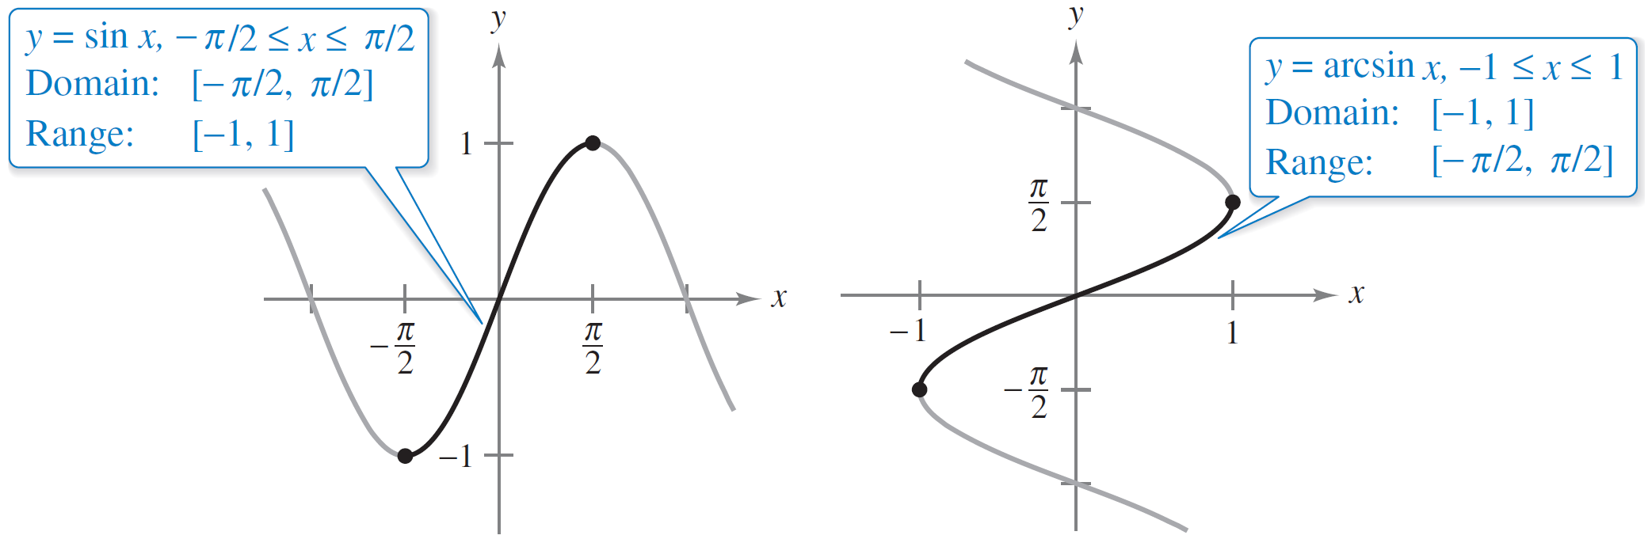
Inverse Trigonometric Functions
For instance, the sine function is one-to-one on the interval
See Figure P.38(a).
(a)
(b)
Figure P.38

Slide 27


Inverse Trigonometric Functions
On this interval, you can define the inverse of the restricted sine function as
y = arcsin x if and only if sin y = x
where
–1 ≤ x ≤ 1 and ≤ arcsin x ≤ .
From Figures P.38 (a) and (b), you can see that you can obtain the graph of y = arcsin x by reflecting the graph of
y = sin x in the line y = x on the interval

Slide 28
Inverse Trigonometric Functions
Under suitable restrictions, each of the six trigonometric functions is one-to-one and so has an inverse function, as indicated in the following definition. (The term “iff” is used to represent the phrase “if and only if.”)

Slide 29
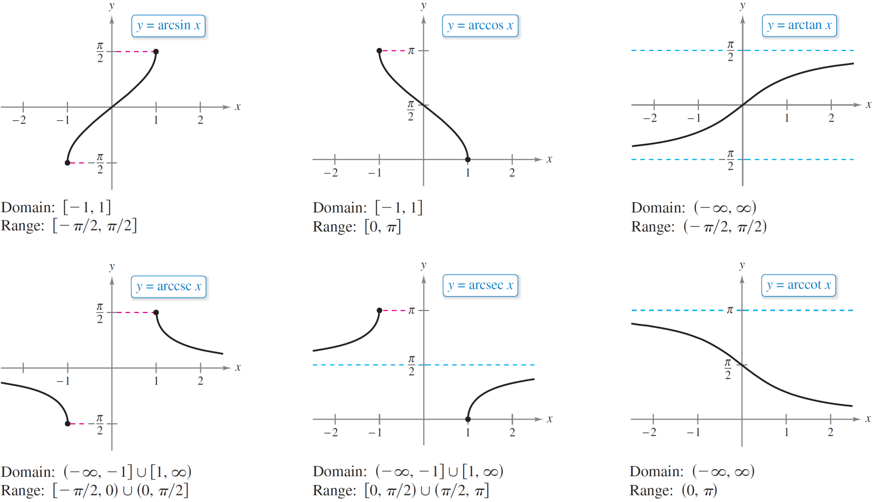
Inverse Trigonometric Functions
The graphs of the six inverse trigonometric functions are shown in Figure P.39.
Figure P.39

Slide 30
Example 5 – Evaluating Inverse Trigonometric Functions
Evaluate each expression.
a. arcsin b. arccos 0
c. arctan d. arcsin(0.3)
Solution:
a. By definition, y = arcsin implies that sin y = In
the interval [–π /2, π /2], the correct value of y is –π /6.

Slide 31
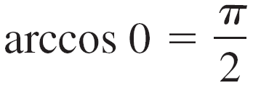

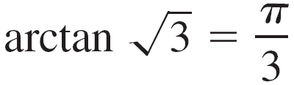
Example 5 – Solution
cont’d
b. By definition, y = arccos 0 implies that cos y = 0. In the
interval [0, π ], you have y = π /2.
c. By definition, y = arctan implies that tan y = . In
the interval (–π /2, π /2), you have y = π /3.
d. Using a calculator set
in radian mode produces
arcsin(0.3) ≈ 0.3047. (See Figure P.40.)
Figure P.40

Slide 32
Inverse Trigonometric Functions
Inverse functions have the properties
f (f ^{–1}(x)) = x and f ^{–1}(f (x)) = x.
When applying these properties to inverse trigonometric functions, remember that the trigonometric functions have inverse functions only in restricted domains.
For x-values outside these domains, these two properties do not hold.
For example, arcsin(sin π) is equal to 0, not π.

Slide 33
Inverse Trigonometric Functions

