Slide 1


P
Preparation for Calculus
Copyright © Cengage Learning. All rights reserved.

Slide 2

P.3
Functions and Their Graphs
Copyright © Cengage Learning. All rights reserved.

Slide 3
Objectives
Use function notation to represent and evaluate
a function.
Find the domain and range of a function.
Sketch the graph of a function.
Identify different types of transformations of
functions.
Classify functions and recognize combinations
of functions.

Slide 4
Functions and Function Notation

Slide 5
Functions and Function Notation
A relation between two sets X and Y is a set of ordered pairs, each of the form (x, y), where x is a member of X and y is a member of Y.
A function from X to Y is a relation between X and Y that has the property that any two ordered pairs with the same x-value also have the same y-value.
The variable x is the independent variable, and the variable y is the dependent variable.

Slide 6
Functions and Function Notation
You can use functions to model many real-life situations. For instance, the area A of a circle is a function of the circle’s radius r.
A = π r²
In this case, r is the independent variable and A is the dependent variable.
A is a function of r.

Slide 7
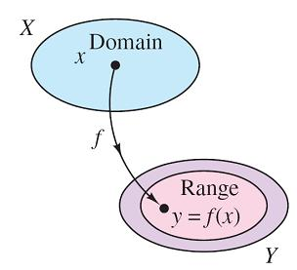
Functions and Function Notation
A real-valued function f of a real variable
Figure P.24

Slide 8
Functions and Function Notation
There are a variety of ways to specify functions. In this text, however, you will concentrate primarily on functions that are given by equations involving the dependent and independent variables.
For instance, the equation
x² + 2y = 1
defines y, the dependent variable, as a function of x, the independent variable.
Equation in implicit form

Slide 9
Functions and Function Notation
To evaluate this function (that is, to find the y-value that corresponds to a given x-value), it is convenient to isolate
y on the left side of the equation.
Using f as the name of the function, you can write this equation as
Equation in explicit form
Function notation

Slide 10
Functions and Function Notation
The original equation, x² + 2y = 1, implicitly defines y as a function of x. When you solve the equation for y, you are writing the equation in explicit form.
Function notation has the advantage of clearly identifying the dependent variable as f (x) while at the same time telling you that x is the independent variable and that the function itself is “f.” The symbol f (x) is read “f of x.”
Function notation allows you to be less wordy. Instead of asking “What is the value of y that corresponds to x = 3?” you can ask, “What is f (3)?”

Slide 11
Functions and Function Notation
In an equation that defines a function of x, the role of the variable x is simply that of a placeholder.
For instance, the function
f (x) = 2x² – 4x + 1
can be described by the form
f ( ) = 2( )² – 4( ) + 1
where rectangles are used instead of x.

Slide 12
Functions and Function Notation
To evaluate f (–2), replace each rectangle with –2.
f (–2) = 2(–2)² – 4(–2) + 1
= 2(4) + 8 + 1
= 17
Substitute –2 for x.
Simplify.
Simplify.

Slide 13
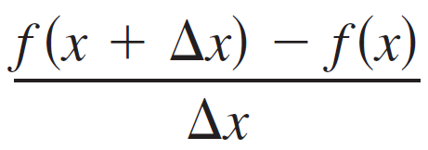
Example 1 – Evaluating a Function
For the function f defined by f (x) = x² + 7, evaluate each expression.
a. f (3a) b. f (b – 1) c.
Solution:
a. f (3a) = (3a)² + 7
= 9a² + 7
b. f (b – 1) = (b – 1)² + 7
= b² – 2b + 1 + 7
Substitute 3a for x.
Simplify.
Substitute b – 1 for x.
Expand binomial.

Slide 14
Example 1 – Solution
cont’d
Simplify.
= b² – 2b + 8
c.
= 2x + Δx, Δx ≠ 0

Slide 15
The Domain and Range of a Function

Slide 16
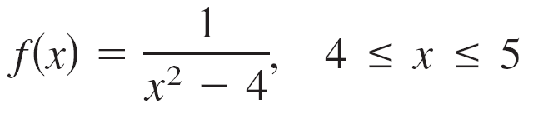
The Domain and Range of a Function
The domain of a function can be described explicitly, or it may be described implicitly by an equation used to define the function.
The implied domain is the set of all real numbers for which the equation is defined, whereas an explicitly defined domain is one that is given along with the function. Below are two examples.
Explicitly defined domain {x: 4 ≤ x ≤ 5}
Implied domain
{x: x ≠ ±2}

Slide 17
Example 2 – Finding the Domain and Range of a Function
Find the domain and range of each function.

Slide 18
Example 2 – Solution
Algebraic Solution:
a. Because the expression under the radical cannot be negative, the domain of is the set of all
real numbers such that So, the domain is the
interval
Because the value of a radical expression is never
negative, the range of is the set of all
nonnegative real numbers. So, the range is the interval

Slide 19
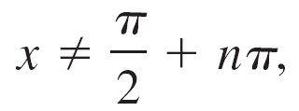
Example 2 – Solution
cont’d
b. Because g is undefined when x = π /2, this value and its odd multiples are not in the domain. So, the domain of
g(x) = tan x is the set of all x-values such that
where n is an integer.
As x gets closer to the values π / 2 and –π / 2,
g(x) increases without bound. So, the range is the interval

Slide 20
Example 2 – Solution
cont’d
c. Because h is defined for x < 1 and x ≥ 1, the domain is the set of all real numbers. So, the domain is the interval
On the portion of the domain for which x ≥ 1, the function behaves as in Example 2(a). For x < 1, the values of
1 – x are positive. So, the range is the set of all nonnegative real numbers, or the interval

Slide 21
Example 2 – Solution
cont’d
Graphical Solution:
a.

Slide 22
Example 2 – Solution
cont’d
b.

Slide 23
Example 2 – Solution
cont’d
c.

Slide 24
The Domain and Range of a Function
A function from X to Y is one-to-one when to each y-value in the range there corresponds exactly one x-value in the domain.
For instance, the function in Example 2(a) is
one-to-one, whereas the function given in Example 2(b) and 2(c) are not one-to-one.
A function from X to Y is onto when its range consists of all of Y.

Slide 25
The Graph of a Function

Slide 26
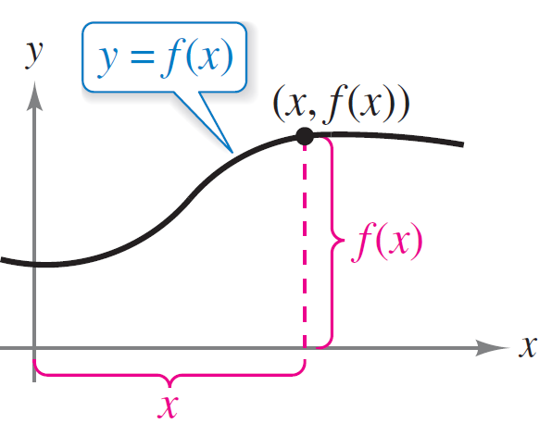
The Graph of a Function
The graph of the function y = f (x) consists of all points
(x, f (x)), where x is in the domain of f.
In Figure P.25, note that
x = the directed distance from
the y-axis
and
f (x) = the directed distance from
the x-axis.
The graph of a function
Figure P.25

Slide 27
The Graph of a Function
A vertical line can intersect the graph of a function of x at most once. This observation provides a convenient visual test, called the Vertical Line Test, for functions of x.
That is, a graph in the coordinate plane is the graph of a function of x if and only if no vertical line intersects the graph at more than one point.

Slide 28
The Graph of a Function
For example, in Figure P.26(a), you can see that the graph does not define y as a function of x because a vertical line intersects the graph twice, whereas in Figures P.26(b) and (c), the graphs do define y as a function of x.
(a) Not a function of x
(b) A function of x
(c) A function of x
Figure P.26

Slide 29
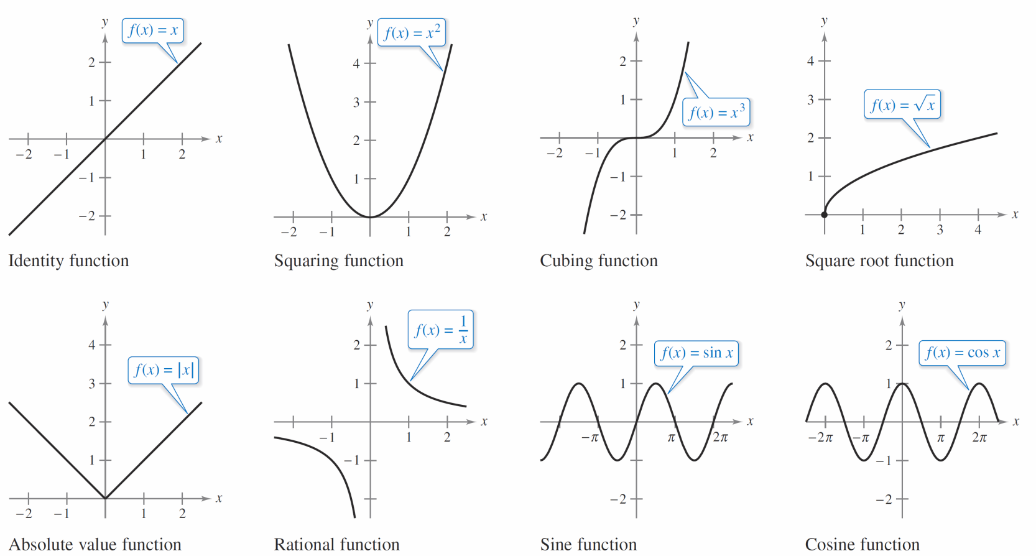
The Graph of a Function
Figure P.27 shows the graphs of eight basic functions. You should be able to recognize these graphs.
The graphs of eight basic functions
Figure P.27

Slide 30
Transformations of Functions

Slide 31
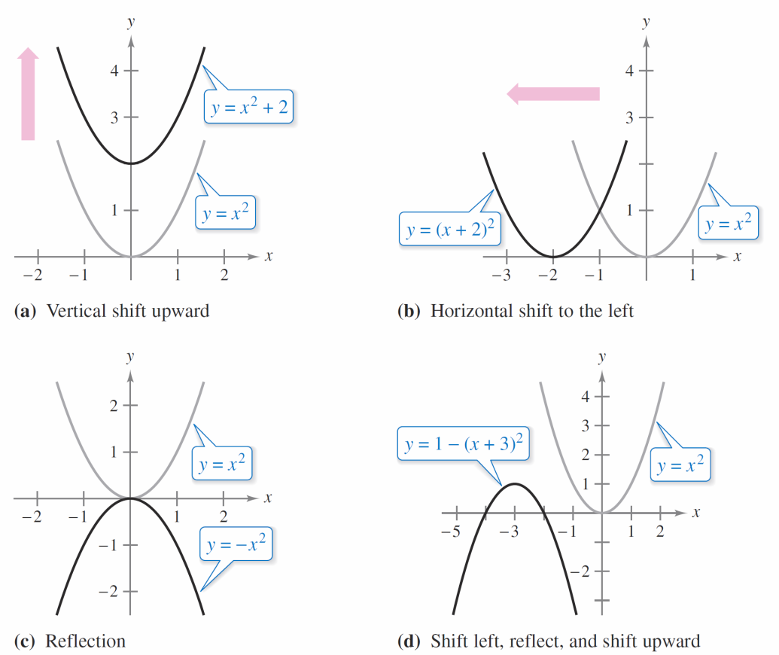
Transformations of Functions
Some families of graphs have the same basic shape. For example, compare the graph of y = x² with the graphs of the four other quadratic functions shown in Figure P.28.
Figure P.28

Slide 32
Transformations of Functions
Each of the graphs in Figure P.28 is a transformation of the graph of y = x². The three basic types of transformations illustrated by these graphs are vertical shifts, horizontal shifts, and reflections. Function notation lends itself well to describing transformations of graphs in the plane.
For instance, using
f (x) = x²
as the original function, the transformations shown in Figure P.28 can be represented by the equations given on the next slide.
Original function

Slide 33
Transformations of Functions
a. y = f (x) + 2
b. y = f (x + 2)
c. y = –f (x)
d. y = –f (x + 3) + 1
Vertical shift up two units
Horizontal shift to the left two units
Reflection about the x-axis
Shift left three units, reflect about the
x-axis, and shift up one unit

Slide 34
Transformations of Functions

Slide 35
Classifications and Combinations of Functions

Slide 36
Classifications and Combinations of Functions
The modern notion of a function is derived from the efforts of many seventeenth- and eighteenth-century mathematicians.
Of particular note was Leonhard Euler (1707–1783), who introduced the function notation y = f (x).
By the end of the eighteenth century, mathematicians and scientists had concluded that many real-world phenomena could be represented by mathematical models taken from a collection of functions called elementary functions.

Slide 37
Classifications and Combinations of Functions
Elementary functions fall into three categories.
1. Algebraic functions (polynomial, radical, rational)
2. Trigonometric functions (sine, cosine, tangent, and so on)
3. Exponential and logarithmic functions

Slide 38
Classifications and Combinations of Functions
The most common type of algebraic function is a polynomial function
where n is a nonnegative integer.
The numbers a_{i} are coefficients, with a_{n} the leading coefficient and a₀ the constant term of the polynomial function.
If a_{n} ≠ 0, then n is the degree of the polynomial function. The zero polynomial f (x) = 0 is not assigned a degree.

Slide 39
Classifications and Combinations of Functions
It is common practice to use subscript notation for coefficients of general polynomial functions, but for polynomial functions of low degree, these simpler forms
are often used. (Note that a ≠ 0.)
Zeroth degree: f (x) = a
First degree: f (x) = ax + b
Second degree: f (x) = ax² + bx + c
Third degree: f (x) = ax³ + bx² + cx + d
Constant function
Linear function
Quadratic function
Cubic function

Slide 40
Classifications and Combinations of Functions
Although the graph of a nonconstant polynomial function can have several turns, eventually the graph will rise or fall without bound as x moves to the right or left.

Slide 41
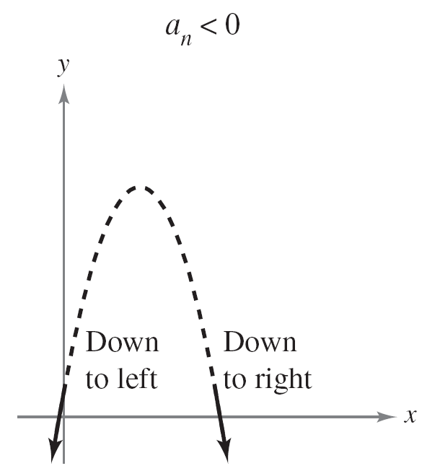
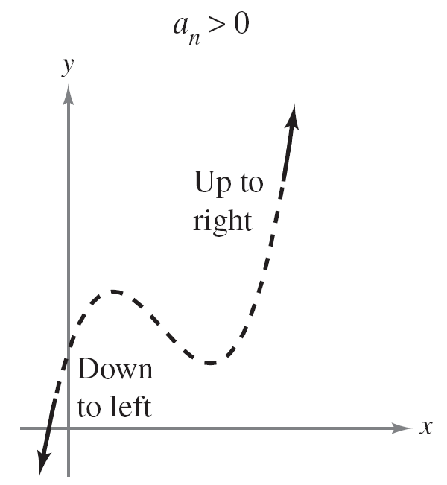
Classifications and Combinations of Functions
Whether the graph of
f (x) = a_{n}x^{n} + a_{n – 1}x^{n – 1} + . . . + a₂x² + a₁x + a₀
eventually rises or falls can be determined by the function’s degree (odd or even) and by the leading coefficient a_{n}, as indicated in Figure P.29.
Graphs of polynomial functions
of even degree
Graphs of polynomial functions
of odd degree
The Leading Coefficient Test for polynomial functions
Figure P.29

Slide 42
Classifications and Combinations of Functions
Note that the dashed portions of the graphs indicate that the Leading Coefficient Test determines only the right and left behavior of the graph.
Just as a rational number can be written as the quotient of two integers, a rational function can be written as the quotient of two polynomials.
Specifically, a function f is rational when it has the form
where p(x) and q(x) are polynomials.

Slide 43

Classifications and Combinations of Functions
Polynomial functions and rational functions are examples of algebraic functions.
An algebraic function of x is one that can be expressed as a finite number of sums, differences, multiples, quotients, and radicals involving x^{n}.
For example, is algebraic. Functions that are not algebraic are transcendental.
For instance, the trigonometric functions are transcendental.

Slide 44
Classifications and Combinations of Functions
There are various ways to combine two functions to create new functions.
For example, given f (x) = 2x – 3 and g(x) = x² + 1, you can form the functions shown.
(f + g)(x) = f (x) + g(x) = (2x – 3) + (x² + 1)
(f – g)(x) = f (x) – g(x) = (2x – 3) – (x² + 1)
(fg)(x) = f (x)g(x) = (2x – 3)(x² + 1)
(f /g)(x) =
Sum
Difference
Product
Quotient

Slide 45
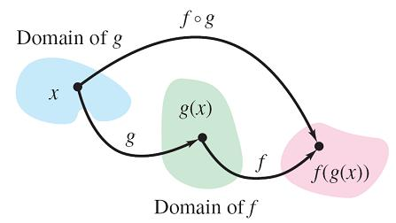
Classifications and Combinations of Functions
You can combine two functions in yet another way, called composition. The resulting function is called a composite function.
The composite of f with g is
generally not the same as
the composite of g with f.
The domain of the composite function f ° g
Figure P.30

Slide 46
Example 3 – Finding Composite Functions
For f (x) = 2x – 3 and g(x) = cos x, find each composite function.
a. f ° g b. g ° f
Solution:
a. (f ° g)(x) = f (g(x))
= f (cos x)
= 2(cos x) – 3
= 2 cos x – 3
Definition of f ° g
Substitute cos x for g(x).
Definition of f (x)
Simplify.

Slide 47
Example 3 – Solution
cont’d
b. (g ° f)(x) = g(f (x))
= g(2x – 3)
= cos(2x – 3)
Note that (f ° g)(x) ≠ (g ° f)(x).
Definition of g ° f
Substitute 2x – 3 for f (x).
Definition of g(x)

Slide 48
Classifications and Combinations of Functions
An x-intercept of a graph is defined to be a point (a, 0) at which the graph crosses the x-axis. If the graph represents a function f, then the number a is a zero of f.
In other words, the zeros of a function f are the solutions of the equation f (x) = 0. For example, the function
f (x) = x – 4
has a zero at x = 4 because f (4) = 0.
We have studied different types of symmetry. In the terminology of functions, a function is even when its graph is symmetric with respect to the y-axis, and is odd when its graph is symmetric with respect to the origin.

Slide 49
Classifications and Combinations of Functions
The symmetry tests yield the following test for even and odd functions.

