Slide 1


P
Preparation for Calculus
Copyright © Cengage Learning. All rights reserved.

Slide 2

Linear Models and Rates
of Change
P.2
Copyright © Cengage Learning. All rights reserved.

Slide 3
Objectives
Find the slope of a line passing through two points.
Write the equation of a line with a given point and slope.
Interpret slope as a ratio or as a rate in a real-life application.
Sketch the graph of a linear equation in slope-intercept form.

Slide 4
Objectives
Write equations of lines that are parallel or perpendicular to a given line.

Slide 5
The Slope of a Line

Slide 6
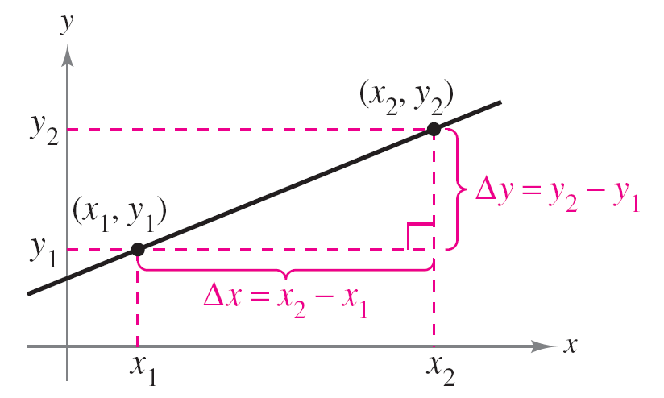
The Slope of a Line
The slope of a nonvertical line is a measure of the number of units the line rises (or falls) vertically for each unit of horizontal change from left to right. Consider the two points (x₁, y₁) and (x₂, y₂) on the line in Figure P.14.
Δy = y₂ – y₁ = change in y
Δx = x₂ – x₁ = change in x
Figure P.14

Slide 7
The Slope of a Line
As you move from left to right along this line, a vertical change of
Δy = y₂ – y₁
units corresponds to a horizontal change of
Δx = x₂ – x₁
units. (Δ is the Greek uppercase letter delta, and the symbols Δy and Δx are read “delta y” and “delta x.”)
Change in y
Change in x

Slide 8
The Slope of a Line

Slide 9
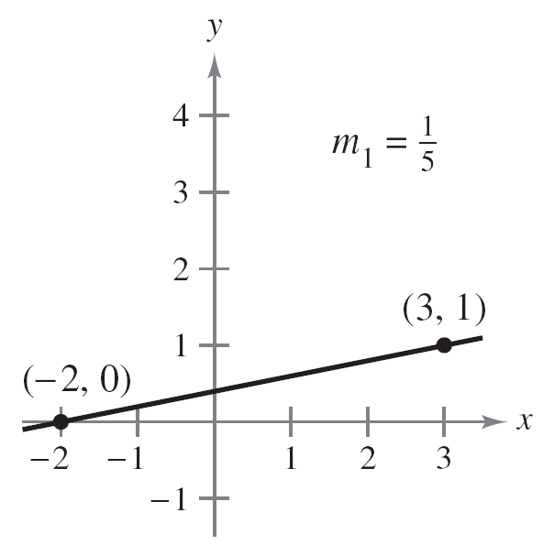
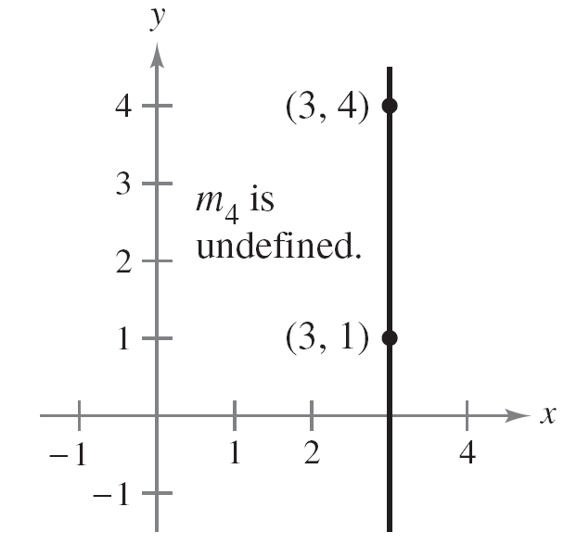
The Slope of a Line
Figure P.15 shows four lines: one has a positive slope, one has a slope of zero, one has a negative slope, and one has an “undefined” slope.
If m is positive, then the line rises from left to right.
If m is zero, then the line is horizontal.
If m is negative, then the line falls from left to right.
If m is undefined, then the line is vertical.
Figure P.15

Slide 10

The Slope of a Line
In general, the greater the absolute value of the slope of a
line, the steeper the line. For instance, in Figure P.15, the
line with a slope of – 5 is steeper than the line with a slope
of .

Slide 11
Equations of Lines

Slide 12
Equations of Lines
Any two points on a nonvertical line can be used to calculate its slope. This can be verified from the similar triangles shown in Figure P.16. (Recall that the ratios of corresponding sides of similar triangles are equal.)
Any two points on a nonvertical line
can be used to determine its slope.
Figure P.16

Slide 13
Equations of Lines
If (x₁, y₁) is a point on a nonvertical line that has a slope of m and (x, y) is any other point on the line, then
This equation in the variables x and y can be rewritten in the form
y – y₁ = m(x – x₁),
which is the point-slope form of the equation of a line.

Slide 14
Equations of Lines

Slide 15
Example 1 – Finding an Equation of a Line
Find an equation of the line that has a slope of 3 and passes through the point (1, –2). Then sketch the line.
Solution:
y – y₁ = m(x – x₁)
y – (–2) = 3(x – 1)
y + 2 = 3x – 3
y = 3x – 5
Point-slope form
Substitute –2 for y₁, 1 for x₁,
and 3 for m.
Simplify.
Solve for y.

Slide 16
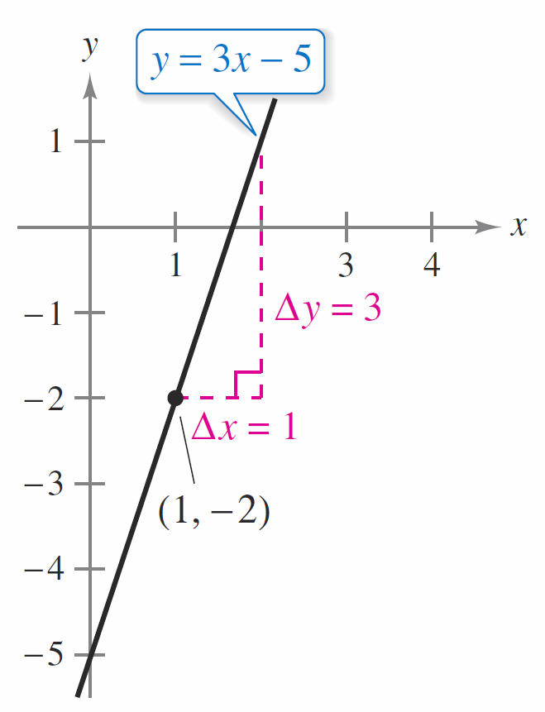
Example 1 – Solution
cont’d
To sketch the line, first plot the
point (1, –2). Then, because the
slope is m = 3, you can locate a
second point on the line by moving
one unit to the right and three
units upward, as shown in
Figure P.17.
The line with a slope of 3 passing
through the point (1, –2)
Figure P.17

Slide 17
Ratios and Rates of Change

Slide 18
Ratios and Rates of Change
The slope of a line can be interpreted as either a ratio or
a rate.
If the x- and y-axes have the same unit of measure, then the slope has no units and is a ratio.
If the x- and y-axes have different units of measure, then the slope is a rate or rate of change.
In your study of calculus, you will encounter applications involving both interpretations of slope.

Slide 19

Example 2 – Using Slope as a Ratio
The maximum recommended slope of a wheelchair ramp
is . A business installs a wheelchair ramp that rises to a
height of 22 inches over a length of 24 feet, as shown in Figure P.18. Is the ramp steeper than recommended?
Solution:
The length of the ramp is 24 feet or 12(24) = 288 inches. The slope of the ramp is the ratio of its height (the rise) to its length (the run).
Figure P.18

Slide 20
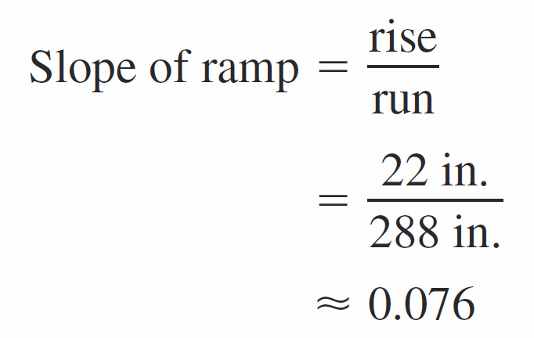

Example 2 – Solution
cont’d
Because the slope of the ramp is less than ,
the ramp is not steeper than recommended. Note that the slope is a ratio and has no units.

Slide 21
Example 3 – Using Slope as a Rate of Change
The population of Nevada was 1,998,000 in 2000 and about 2,759,000 in 2012. Find the average rate of change of the population over this 12-year period. What will the population of Nevada be in 2020?
Solution:
Over this 12-year period, the average rate of change of the population of Nevada was

Slide 22
Example 3 – Solution
cont’d
Assuming that Nevada’s population continues to increase at this same rate for the next 8 years, it will have a 2020 population of 3,266,336 (see Figure P.19).
Population of Nevada
Figure P.19

Slide 23
Ratios and Rates of Change
The rate of change found in Example 3 is an average rate of change.
An average rate of change is always calculated over an interval. In this case, the interval is [2000, 2012].

Slide 24
Graphing Linear Models

Slide 25
Graphing Linear Models
Many problems in coordinate geometry can be classified into two basic categories:
1. Given a graph (or parts of it), find its equation.
2. Given an equation, sketch its graph.
For lines, you can solve problems in the first category by using the point-slope form.
The point-slope form, however, is not especially useful for solving problems in the second category.

Slide 26
Graphing Linear Models
The form that is better suited to sketching the graph of a line is the slope-intercept form of the equation of a line.

Slide 27
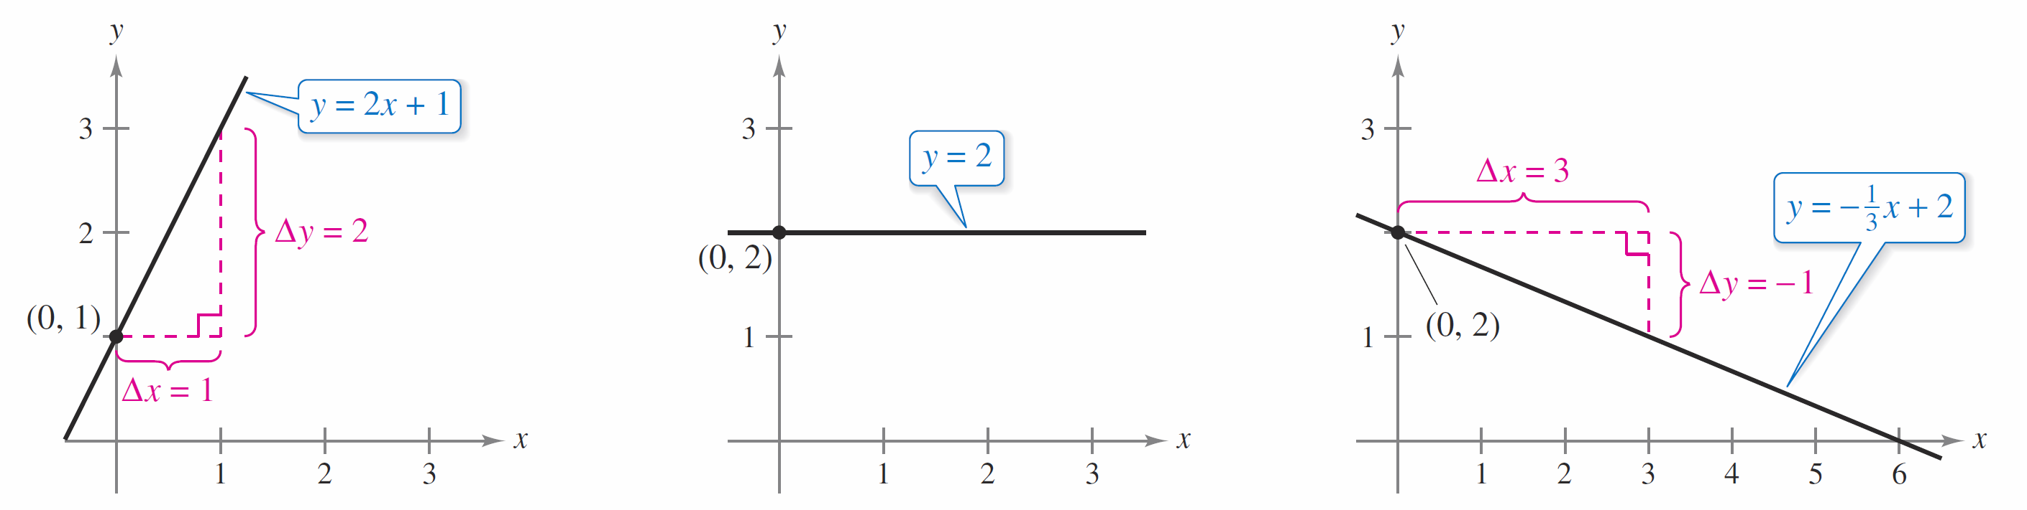
Example 4 – Sketching Lines in the Plane
Sketch the graph of each equation.
a. y = 2x + 1 b. y = 2 c. 3y + x – 6 = 0
Solution:
a. Because b = 1, the y-intercept is (0, 1).
Because the slope is m = 2,
you know that the line rises
two units for each unit it moves
to the right, as shown in
Figure P.20(a).
m = 2; line rises
Figure P.20(a)

Slide 28
Example 4 – Solution
cont’d
b. By writing the equation y = 2 in slope-intercept form
y = (0)x + 2
you can see that the slope is
m = 0 and the y-intercept is (0, 2).
Because the slope is zero, you
know that the line is horizontal,
as shown in Figure P.20(b).
m = 0; line is horizontal
Figure P.20(b)

Slide 29
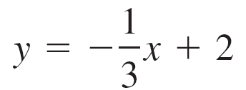

Example 4 – Solution
cont’d
c. Begin by writing the equation in slope-intercept form.
3y + x – 6 = 0
3y = –x + 6
In this form, you can see that the y-intercept is (0, 2) and
the slope is m = .
Write original equation.
Isolate y-term on the left.
Slope-intercept form

Slide 30
Example 4 – Solution
cont’d
This means that the line falls one unit for every three
units it moves to the right, as shown in Figure P.20(c).
m = ; line falls
Figure P.20(c)

Slide 31
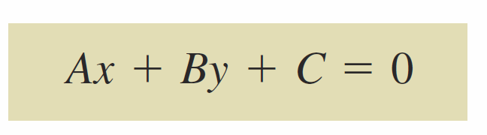
Graphing Linear Models
Because the slope of a vertical line is not defined, its equation cannot be written in the slope-intercept form. However, the equation of any line can be written in the general form
where A and B are not both zero. For instance, the vertical line
x = a
can be represented by the general form
x – a = 0.
General form of the equation of a line
Vertical line
General form

Slide 32
Graphing Linear Models

Slide 33
Parallel and Perpendicular Lines

Slide 34
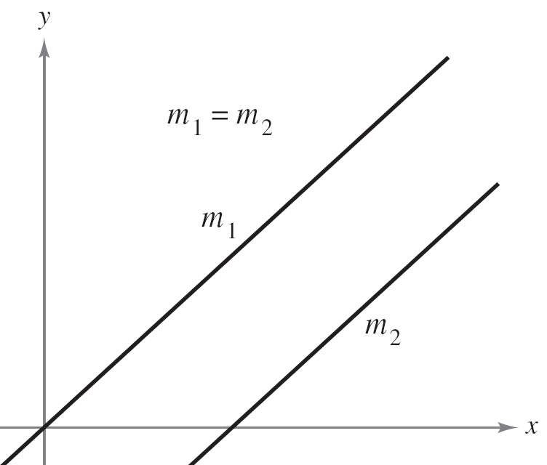
Parallel and Perpendicular Lines
The slope of a line is a convenient tool for determining whether two lines are parallel or perpendicular, as shown in Figure P.21. Specifically, nonvertical lines with the same slope are parallel, and nonvertical lines whose slopes are negative reciprocals are perpendicular.
Parallel lines
Perpendicular lines
Figure P.21

Slide 35
Parallel and Perpendicular Lines

Slide 36
Example 5 – Finding Parallel and Perpendicular Lines
Find the general forms of the equations of the lines that pass through the point (2, –1) and are (a) parallel to and
(b) perpendicular to the line 2x – 3y = 5.
Solution:
Begin by writing the linear equation 2x – 3y = 5 in
slope-intercept form.
2x – 3y = 5
Write original equation.
Slope-intercept form

Slide 37

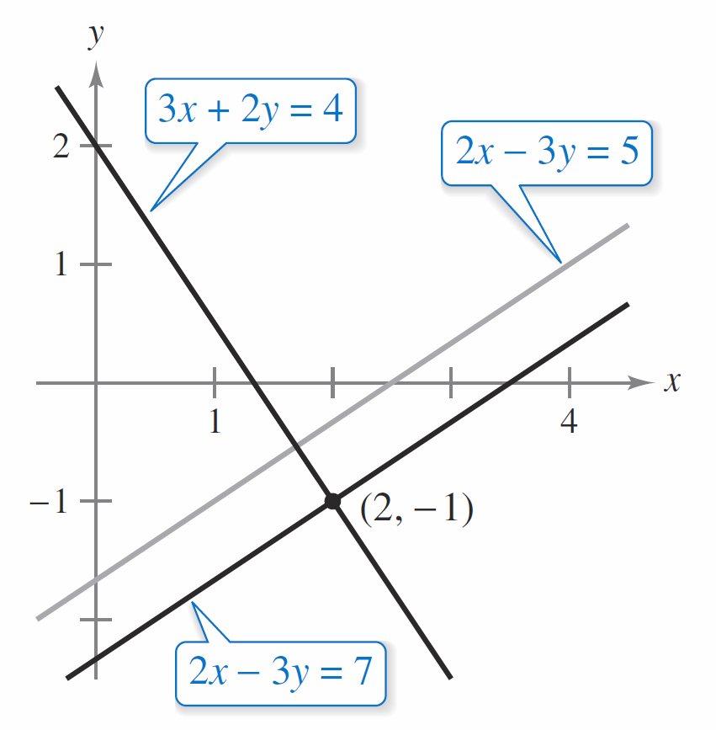
Example 5 – Solution
cont’d
So, the given line has a slope of m = (See Figure P.22.)
Lines parallel and perpendicular to 2x – 3y = 5
Figure P.22

Slide 38
Example 5 – Solution
cont’d
a. The line through (2, –1) that is parallel to the given line also has a slope of
y – y₁ = m(x – x₁)
y – (–1) = (x – 2)
3(y + 1) = 2(x – 2)
3y + 3 = 2x – 4
2x – 3y – 7 = 0
Note the similarity to the equation of the given line,
2x – 3y = 5.
Point-slope form
Substitute.
Simplify.
Distributive Property
General form (See Figure P.22.)

Slide 39

Example 5 – Solution
cont’d
b. Using the negative reciprocal of the slope of the given
line, you can determine that the slope of a line perpendicular to the given line is
y – y₁ = m(x – x₁)
y – (–1) = (x – 2)
2(y + 1) = –3(x – 2)
2y + 2 = –3x + 6
3x + 2y – 4 = 0
Point-slope form
Substitute.
Simplify.
Distributive Property
General form (See Figure P.22.)

