Slide 1


P
Preparation for Calculus
Copyright © Cengage Learning. All rights reserved.

Slide 2

P.1
Graphs and Models
Copyright © Cengage Learning. All rights reserved.

Slide 3
Objectives
Sketch the graph of an equation.
Find the intercepts of a graph.
Test a graph for symmetry with respect to an
axis and the origin.
Find the points of intersection of two graphs.
Fit a mathematical model to a real-life data set.

Slide 4
The Graph of an Equation

Slide 5
The Graph of an Equation
The French mathematician René Descartes revolutionized the study of mathematics by combining its two major fields—algebra and geometry.
With Descartes’s coordinate plane, geometric concepts could be formulated analytically and algebraic concepts could be viewed graphically. The power of this approach was such that within a century of its introduction, much of calculus had been developed.
The same approach can be followed in your study of calculus. That is, by viewing calculus from multiple perspectives—graphically, analytically, and numerically—you will increase your understanding of core concepts.

Slide 6
The Graph of an Equation
Consider the equation 3x + y = 7. The point (2, 1) is a solution point of the equation because the equation is satisfied (is true) when 2 is substituted for x and 1 is substituted for y.
This equation has many other solutions, such as (1, 4) and (0, 7). To find other solutions systematically, solve the original equation for y.
y = 7 – 3x
Analytic approach

Slide 7
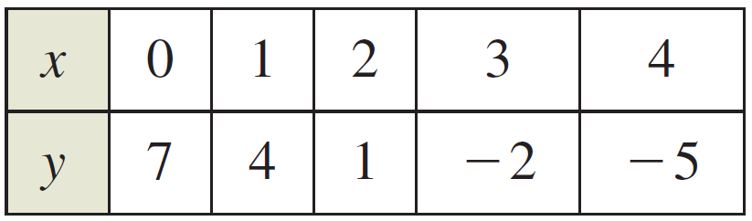
The Graph of an Equation
Then construct a table of values by substituting several values for x.
From the table, you can see that (0, 7), (1, 4), (2, 1),
(3, –2), and (4, –5) are solutions of the original equation
3x + y = 7.
Numerical approach

Slide 8
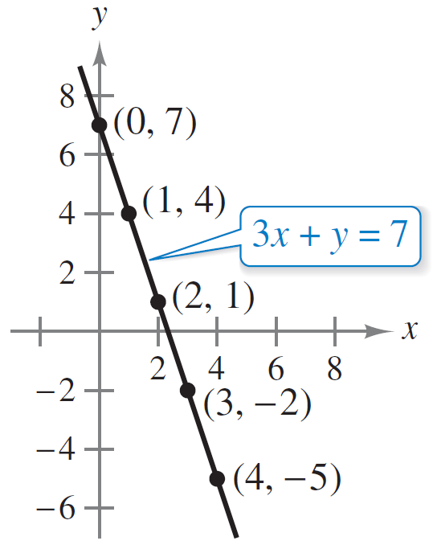
The Graph of an Equation
Like many equations, this equation has an infinite number of solutions. The set of all solution points is the graph of the equation, as shown in Figure P.1.
Graphical approach: 3x + y = 7
Figure P.1

Slide 9
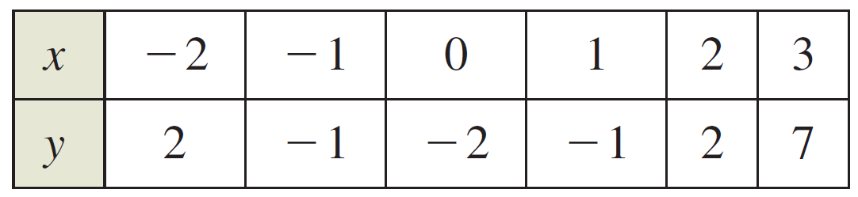
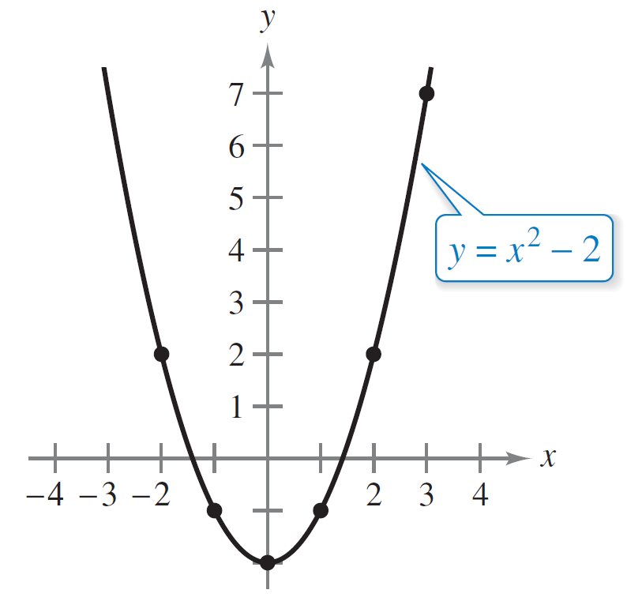
Example 1 – Sketching a Graph by Point Plotting
Sketch the graph of y = x² – 2.
Solution:
First construct a table of values.
Next, plot the points shown in
the table.
Then connect the points with
a smooth curve, as shown in
Figure P.2. This graph is a
parabola.
The parabola y = x² – 2
Figure P.2

Slide 10
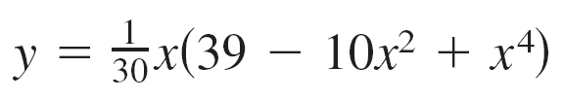
The Graph of an Equation
One disadvantage of point plotting is that to get a good idea about the shape of a graph, you may need to plot many points.
With only a few points, you could badly misrepresent the graph. For instance, to sketch the graph of
you plot five points:
(–3, –3), (–1, –1), (0, 0), (1, 1),
and (3, 3) as shown in
Figure P.3(a).
Figure P.3(a)

Slide 11
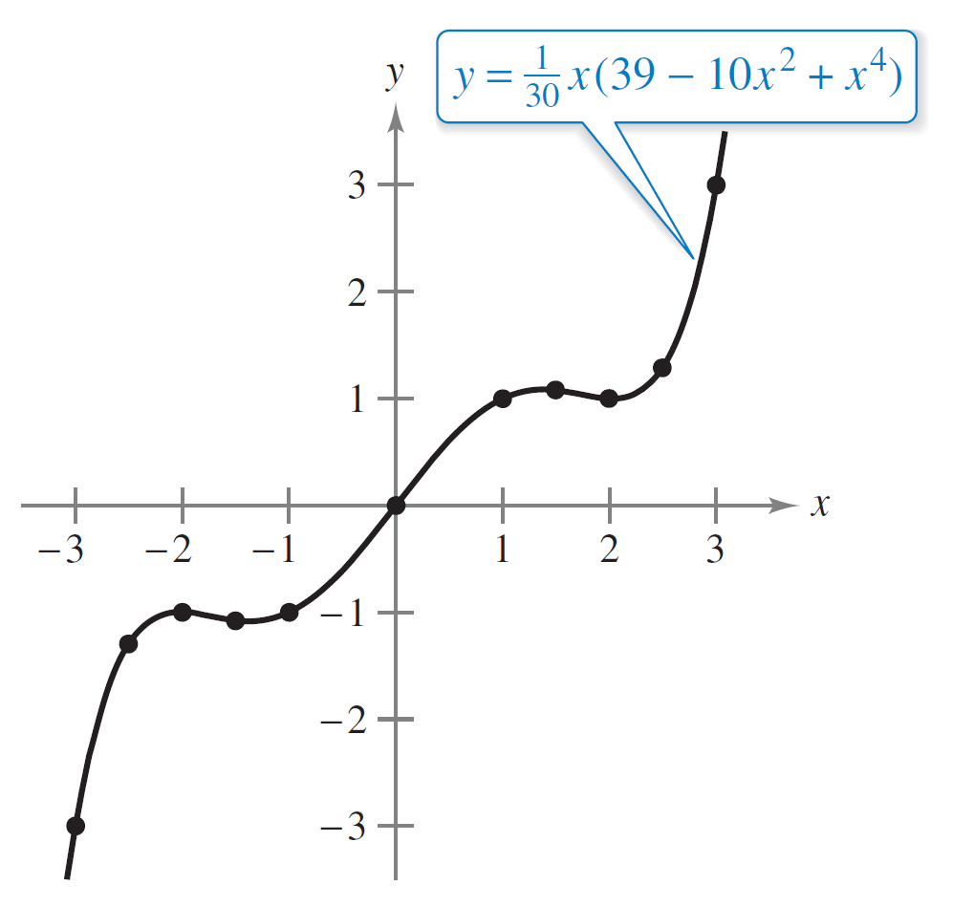
The Graph of an Equation
From these five points, you might conclude that the graph
is a line.
This, however, is not correct.
By plotting several more points,
you can see that the graph is
more complicated, as shown
in Figure P.3(b).
Figure P.3(b)

Slide 12
Intercepts of a Graph

Slide 13
Intercepts of a Graph
Two types of solution points that are especially useful in graphing an equation are those having zero as their x- or y-coordinate.
Such points are called intercepts because they are the points at which the graph intersects the x- or y-axis.
The point (a, 0) is an x-intercept of the graph of an equation when it is a solution point of the equation.
To find the x-intercepts of a graph, let y be zero and solve the equation for x.

Slide 14
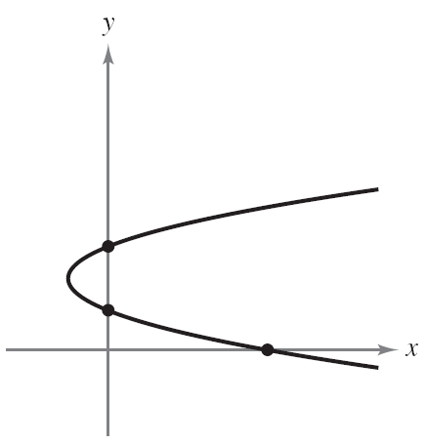
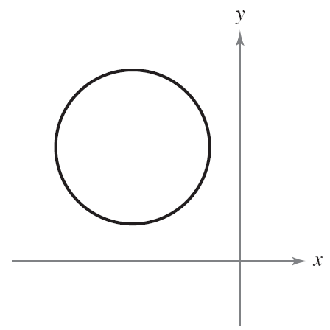
Intercepts of a Graph
The point (0, b) is a y-intercept of the graph of an equation when it is a solution point of the equation. To find the y-intercepts of a graph, let x be zero and solve the equation for y.
It is possible for a graph to have no intercepts, or it might have several. For instance, consider the four graphs shown in Figure P.5.
No x-intercepts
One y-intercept
Three x-intercepts
One y-intercept
One x-intercept
Two y-intercepts
No intercepts
Figure P.5

Slide 15
Example 2 – Finding x- and y-intercepts
Find the x- and y-intercepts of the graph of y = x³ – 4x.
Algebraic Solution:
To find the x-intercepts, let y be zero and solve for x.
Let y be zero.
Factor.
Set first factor
equal to zero.
Set second factor
equal to zero.
Set third factor
equal to zero.

Slide 16
Example 2 – Solution
cont’d
Because this equation has three solutions, you can conclude that the graph has three x-intercepts:
(0, 0), (2, 0), and (–2, 0).
To find the y-intercepts, let x be zero. Doing this produces
y = 0. So, the y-intercept is
(0, 0).
x-intercepts
y-intercepts

Slide 17
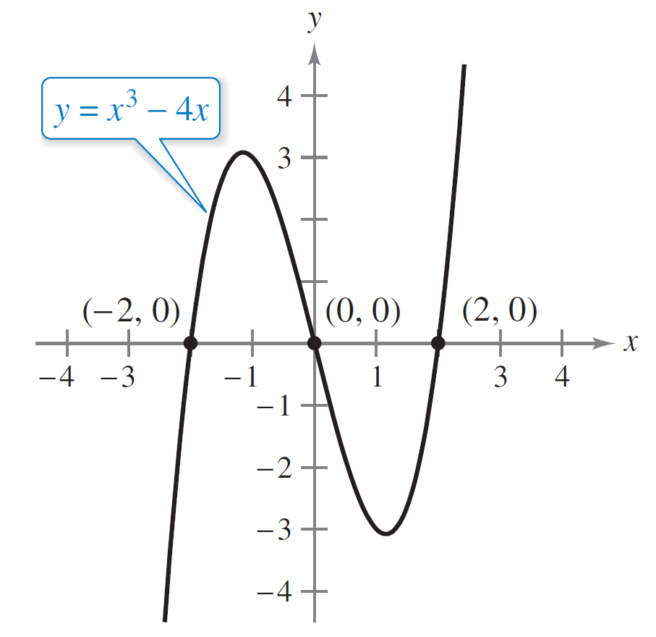
Example 2 – Solution
cont’d
Graphical Solution:
The graph of y = x³ – 4x has the x-intercepts (–2, 0),
(0, 0), and (2, 0) and the y-intercept (0, 0), as shown in
Figure P.6.
Intercepts of y = x³ – 4x
Figure P.6

Slide 18
Example 2 – Solution
cont’d
Use the zero or root feature of a graphing utility to verify these intercepts. (See Figure P.7.)
Figure P.7

Slide 19
Symmetry of a Graph

Slide 20
Symmetry of a Graph
Knowing the symmetry of a graph before attempting to sketch it is useful because you need only half as many points to sketch the graph. The three types of symmetry can be used to help sketch the graphs of equations (see Figure P.8).
Figure P.8

Slide 21
Symmetry of a Graph
1. A graph is symmetric with respect to the y-axis if, whenever (x, y) is a point on the graph, then (–x, y) is also a point on the graph. This means that the portion of the graph to the left of the y-axis is a mirror image of the portion to the right of the y-axis.
2. A graph is symmetric with respect to the x-axis if, whenever (x, y) is a point on the graph, then (x, –y) is also a point on the graph. This means that the portion of the graph above the x-axis is a mirror image of the portion below the x-axis.

Slide 22
Symmetry of a Graph
3. A graph is symmetric with respect to the origin if, whenever (x, y) is a point on the graph, then (–x, –y) is also a point on the graph. This means that the graph is
unchanged by a rotation of 180° about the origin.

Slide 23
Symmetry of a Graph
The graph of a polynomial has symmetry with respect to the y-axis when each term has an even exponent (or is a constant).
For instance, the graph of y = 2x⁴ – x² + 2 has symmetry with respect to the y-axis.
Similarly, the graph of a polynomial has symmetry with respect to the origin when each term has an odd exponent, as illustrated in Example 3.

Slide 24
Example 3 – Testing for Symmetry
Test the graph of y = 2x³ – x for symmetry with respect to (a) the y-axis and (b) the origin.
Solution:
a. y = 2x³ – x
y = 2(–x³) – (–x)
y = –2x³ + x
Because replacing x by –x does not yield an equivalent equation, you can conclude that the graph of y = 2x³ – x is not symmetric with respect to the y-axis.
Write original equation.
Replace x by –x.
Simplify. It is not an equivalent equation.

Slide 25
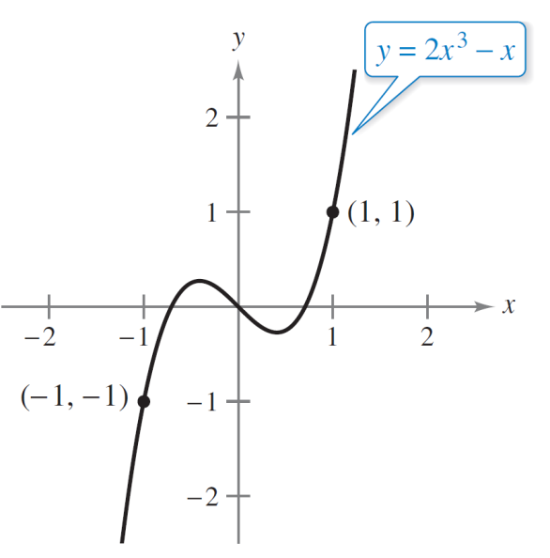
Example 3 – Solution
cont’d
b. y = 2x³ – x
–y = 2(–x³) – (–x)
–y = –2x³ + x
y = 2x³ – x
Because replacing x by –x and y by –y
yields an equivalent equation,
you can conclude that the graph
of y = 2x³ – x is symmetric with respect
to the origin, as shown in Figure P.9.
Write original equation.
Replace x by –x and y by –y.
Simplify.
Equivalent equation
Origin symmetry
Figure P.9

Slide 26
Points of Intersection

Slide 27
Points of Intersection
A point of intersection of the graphs of two equations is a point that satisfies both equations.
One way to find the point(s) of intersection of two graphs is by solving their equations simultaneously.

Slide 28
Example 5 – Finding Points of Intersection
Find all points of intersection of the graphs of x² – y = 3 and x – y = 1.
Algebraic Solution:
To find the points of intersection analytically, solve both equations for y, set the two y-values equal to each other, and solve the resulting equation.
y = x² – 3
y = x – 1
x² – 3 = x – 1
Solve first equation for y.
Solve second equation for y.
Equate y-values.

Slide 29
Example 5 – Solution
cont’d
x² – x – 2 = 0
(x – 2)(x + 1) = 0
x = 2 or –1
The corresponding values of y are obtained by substituting x = 2 and x = –1 into either of the original equations. Doing this produces two points of intersection:
(2, 1) and (–1, –2).
Write in general form.
Factor.
Solve for x.
Points of intersection

Slide 30
Example 5 – Solution
cont’d
Graphical Solution:
Begin by solving both equations for y. Then use a graphing utility to graph the equations y₁ = x² – 3 and y₂ = x – 1 in the same viewing window. Use the intersect feature (see figure below) to find the points of intersection of the graphs.

Slide 31
Fitting Mathematical Models to Data

Slide 32
Fitting Mathematical Models to Data
One basic technique of modern science is gathering data and then describing the data with a mathematical models.
In developing a mathematical model to represent actual data, you should strive for two (often conflicting) goals—accuracy and simplicity.
That is, you want the model to be simple enough to be workable, yet accurate enough to produce meaningful results.

Slide 33
Example 6 – Fitting a Linear Model to Data
A class of 28 people collected the data shown below, which represent their heights x and arm spans y (rounded to the nearest inch).
Find a linear model to represent these data.

Slide 34
Example 6 – Solution
There are different ways to model these data with an equation. The simplest would be to observe that x and y are about the same and list the model as simply y = x. A more careful analysis would be to use a procedure from statistics called least squares regression.
The least squares regression line for these data is
Least squares regression line

Slide 35
Example 6 – Solution
cont’d
The graph of the model and the data are shown in
Figure P.11. From this model, you can see that a person’s arm span tends to be about the same as his or her height.
Linear model and data
Figure P.11

Slide 36
Fitting Mathematical Models to Data
An equation that gives the height s of a falling object in terms of the time t is called a position equation. If air resistance is not considered, then the position of a falling object can be modeled by
where g is the acceleration due to gravity, v₀ is the initial velocity, and s₀ is the initial height. The value of g depends on where the object is dropped.
On Earth, g is approximately –32 feet per second per second, or –9.8 meters per second per second.

Slide 37
Fitting Mathematical Models to Data
1. Mathematical modeling consists of applying your mathematical skills to obtain useful answers to real problems.
2. Learning to apply mathematical skills is very different from learning mathematics itself.
3. Models are used in a very wide range of applications, some of which do not appear initially to be mathematical in nature.
4. Models often allow quick and cheap evaluation of alternatives, leading to optimal solutions that are not otherwise obvious.

Slide 38
Fitting Mathematical Models to Data
5. There are no precise rules in mathematical modeling and no “correct” answers.
6. Modeling can be learned only by doing.

