Slide 1

4
Integration
Copyright © Cengage Learning. All rights reserved.

Slide 2

4.5
Integration by Substitution
Copyright © Cengage Learning. All rights reserved.

Slide 3
Objectives
Use pattern recognition to find an indefinite integral.
Use a change of variables to find an indefinite integral.
Use the General Power Rule for Integration to find an indefinite integral.

Slide 4
Objectives
Use a change of variables to evaluate a definite integral.
Evaluate a definite integral involving an even or odd function.

Slide 5
Pattern Recognition

Slide 6
Pattern Recognition
In this section, you will study techniques for integrating composite functions. The discussion is split into two
parts—pattern recognition and change of variables.
Both techniques involve a u-substitution. With pattern recognition, you perform the substitution mentally, and with change of variables, you write the substitution steps.
The role of substitution in integration is comparable to the role of the Chain Rule in differentiation.

Slide 7
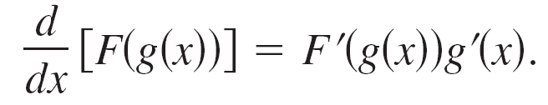
Pattern Recognition
Recall that for the differentiable functions
y = F (u) and u = g(x)
the Chain Rule states that
From the definition of an antiderivative, it follows that

Slide 8
Pattern Recognition
These results are summarized in the following theorem.

Slide 9
Pattern Recognition
Example 1 shows how to apply Theorem 4.15 directly, by recognizing the presence of f (g(x)) and g′(x).
Note that the composite function in the integrand has an outside function f and an inside function g. Moreover, the derivative g′(x) is present as a factor of the integrand.

Slide 10
Example 1 – Recognizing the f (g(x))g′(x) Pattern
Find ∫ (x² + 1)²(2x) dx.
Solution:
Letting g(x) = x² + 1, you obtain
g′(x) = 2x
and
f (g(x)) = f (x² + 1)
= (x² + 1)².

Slide 11
Example 1 – Solution
cont’d
From this, you can recognize that the integrand follows the
f (g(x))g′(x) pattern.
Using the Power Rule for Integration and Theorem 4.15, you can write
Try using the Chain Rule to check that the derivative of
is the integrand of the original integral.

Slide 12
Pattern Recognition
The integrands in Example 1 fit the f (g(x))g′(x) pattern exactly—you only had to recognize the pattern.
You can extend this technique considerably with the Constant Multiple Rule
Many integrands contain the essential part (the variable part) of g′(x) but are missing a constant multiple. In such cases, you can multiply and divide by the necessary constant multiple.

Slide 13
Change of Variables for Indefinite Integrals

Slide 14
Change of Variables for Indefinite Integrals
With a formal change of variables, you completely rewrite the integral in terms of u and du (or any other convenient variable). Although this procedure can involve more written steps than the pattern recognition illustrated in Example 1, it is useful for complicated integrands.
The change of variables technique uses the Leibniz notation for the differential. That is, if u = g(x), then
du = g′(x) dx, and the integral in Theorem 4.15 takes the form

Slide 15

Example 4 – Change of Variables
Find
Solution:
First, let u be the inner function, u = 2x – 1.
Then calculate the differential du to be du = 2 dx.
Now, using and dx = du/2, substitute to obtain
Integral in terms of u

Slide 16
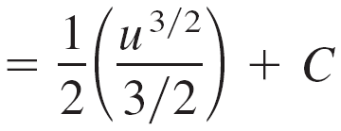
Example 4 – Solution
cont’d
Constant Multiple Rule
Antiderivative in terms of u
Simplify.
Antiderivative in terms of x

Slide 17
Change of Variables for Indefinite Integrals
The steps used for integration by substitution are summarized in the following guidelines.

Slide 18
The General Power Rule for Integration

Slide 19
The General Power Rule for Integration
One of the most common u-substitutions involves quantities in the integrand that are raised to a power. Because of the importance of this type of substitution, it is given a special name—the General Power Rule for Integration.

Slide 20
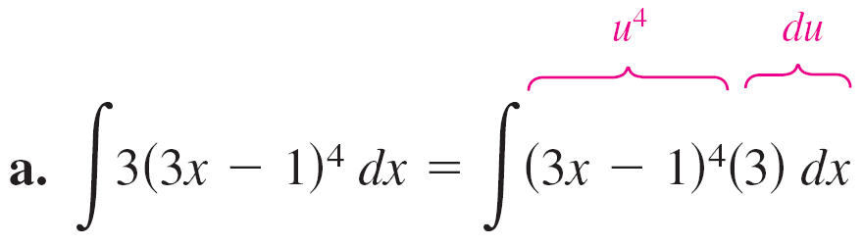
Example 7 – Substitution and the General Power Rule

Slide 21
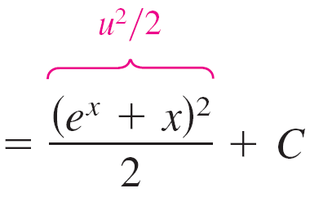
Example 7 – Substitution and the General Power Rule
cont’d

Slide 22
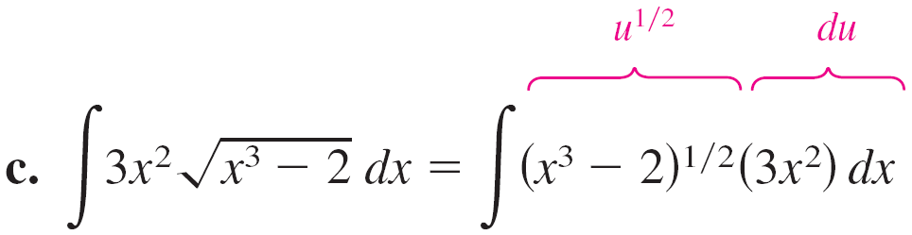
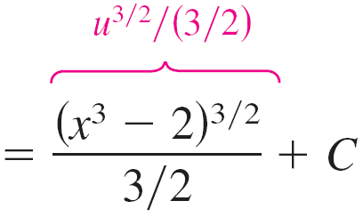
Example 7 – Substitution and the General Power Rule
cont’d

Slide 23
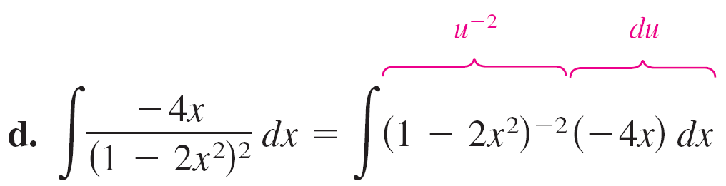
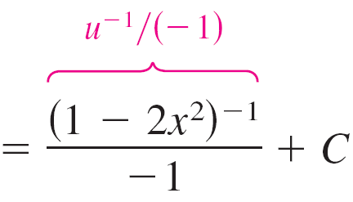
Example 7 – Substitution and the General Power Rule
cont’d

Slide 24
Example 7 – Substitution and the General Power Rule
cont’d

Slide 25
The General Power Rule for Integration
Some integrals whose integrands involve quantities raised to powers cannot be found by the General Power Rule. Consider the two integrals
∫ x(x² + 1)² dx and ∫ (x² + 1)² dx.
The substitution
u = x² + 1
works in the first integral, but not in the second. In the second, the substitution fails because the integrand lacks the factor x needed for du.

Slide 26
The General Power Rule for Integration
Fortunately, for this particular integral, you can expand the integrand as
(x² + 1)² = x⁴ + 2x² + 1
and use the (simple) Power Rule to integrate each term.

Slide 27
Change of Variables for Definite Integrals

Slide 28
Change of Variables for Definite Integrals
When using u-substitution with a definite integral, it is often convenient to determine the limits of integration for the variable u rather than to convert the antiderivative back to the variable x and evaluate at the original limits.
This change of variables is stated explicitly in the following theorem.

Slide 29

Example 9 – Change of Variables
Evaluate the definite integral.
Solution:
To evaluate this integral, let
Then, you obtain
u² = 2x – 1
u² + 1 = 2x

Slide 30

Example 9 – Solution
cont’d
u du = dx.
Before substituting, determine the new upper and lower limits of integration.
Lower Limit
When x = 1,
Upper Limit
When x = 5,
Differentiate each side.

Slide 31
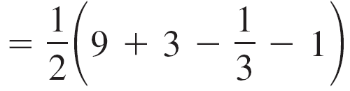
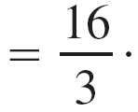
Example 9 – Solution
cont’d
Now, substitute to obtain

Slide 32
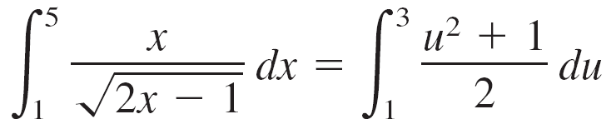
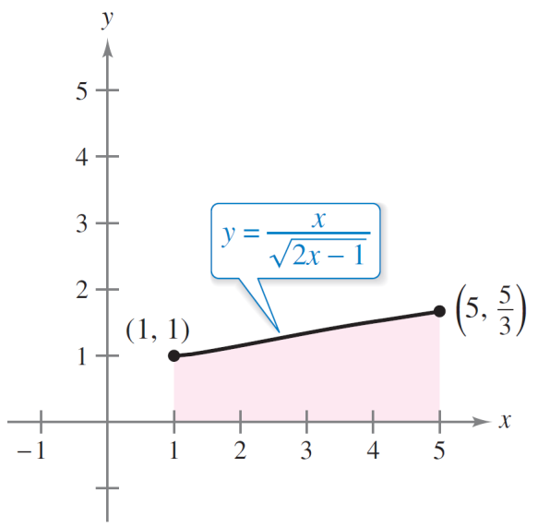
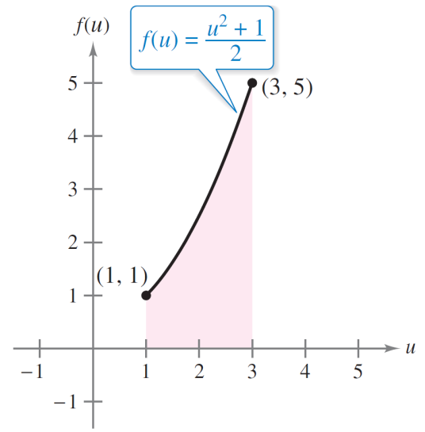
Change of Variables for Definite Integrals
Geometrically, you can interpret the equation
to mean that the two different regions shown in
Figures 4.42 and 4.43 have the same area.
The region before substitution
has an area of
The region after substitution
has an area of
Figures 4.42
Figures 4.43

Slide 33

Change of Variables for Definite Integrals
When evaluating definite integrals by substitution, it is possible for the upper limit of integration of the u-variable form to be smaller than the lower limit. When this happens, do not rearrange the limits. Simply evaluate as usual.
For example, after substituting in the integral
you obtain when x = 1, and
when x = 0.

Slide 34
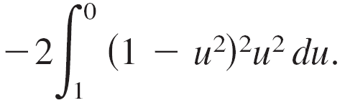
Change of Variables for Definite Integrals
So, the correct u-variable form of this integral is

Slide 35
Integration of Even and Odd Functions

Slide 36
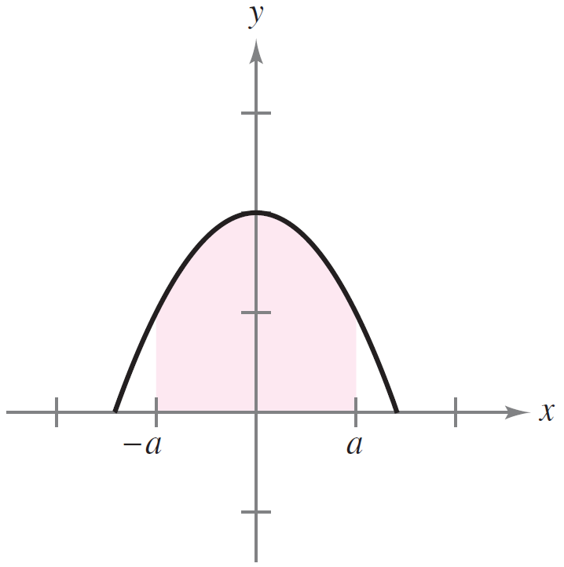
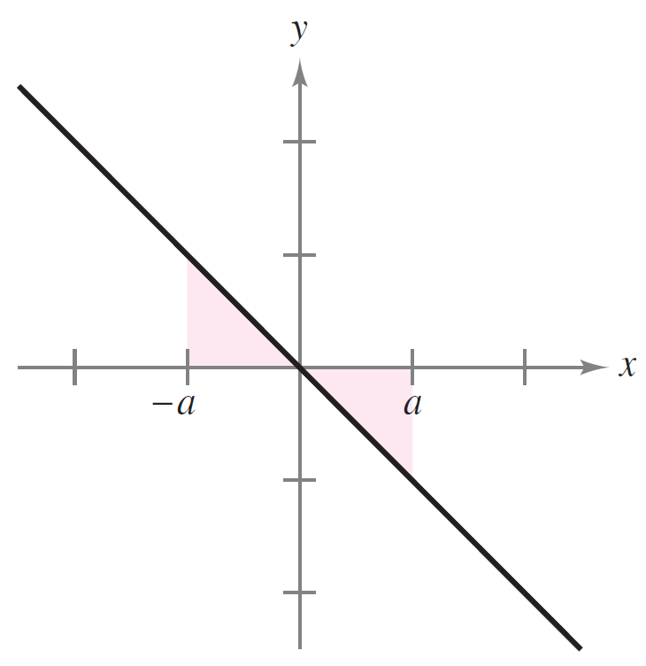
Integration of Even and Odd Functions
Even with a change of variables, integration can be difficult. Occasionally, you can simplify the evaluation of a definite integral over an interval that is symmetric about the y-axis or about the origin by recognizing the integrand to be an even or odd function (See Figure 4.44.).
Even function
Odd function
Figure 4.44

Slide 37
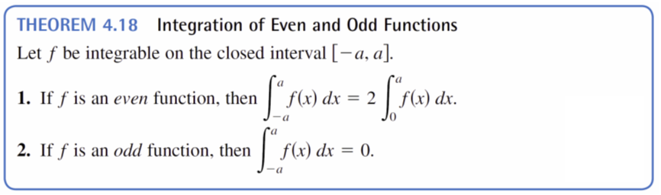
Integration of Even and Odd Functions

Slide 38
Example 10 – Integration of an Odd Function
Evaluate the definite integral.
Solution:
Letting f (x) = sin³ x cos x + sin x cos x produces
f (–x) = sin³(–x)cos(–x) + sin(–x)cos(–x)
= – sin³ x cos x – sin x cos x
= –f (x).

Slide 39
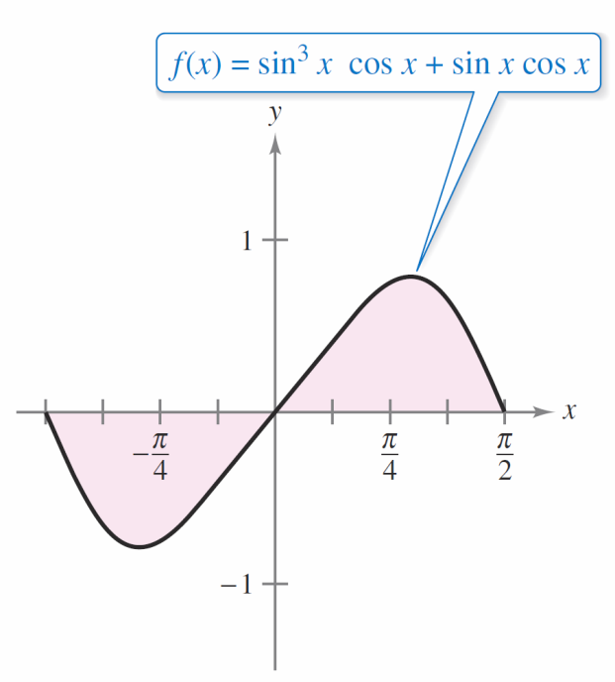

Example 10 – Solution
cont’d
So, f is an odd function, and because f is symmetric about the origin over [–π /2, π /2], you can apply Theorem 4.18 to conclude that
From Figure 4.45, you can
see that the two regions on
either side of the y-axis have
the same area. However,
because one lies below the
x-axis and one lies above it,
integration produces a
cancellation effect.
Because f is an odd function,
Figure 4.45

