Slide 1

4
Integration
Copyright © Cengage Learning. All rights reserved.

Slide 2

Riemann Sums and
Definite Integrals
4.3
Copyright © Cengage Learning. All rights reserved.

Slide 3
Objectives
Understand the definition of a Riemann sum.
Evaluate a definite integral using limits.
Evaluate a definite integral using properties of definite integrals.
Approximate a definite integral using the Trapezoidal Rule.

Slide 4
Objectives
Analyze the approximate errors in the Trapezoidal Rule.

Slide 5
Riemann Sums

Slide 6
Riemann Sums
In the definition of area, the partitions have subintervals of equal width. This was done only for computational convenience.
The next example shows that it is not necessary to have subintervals of equal width.

Slide 7
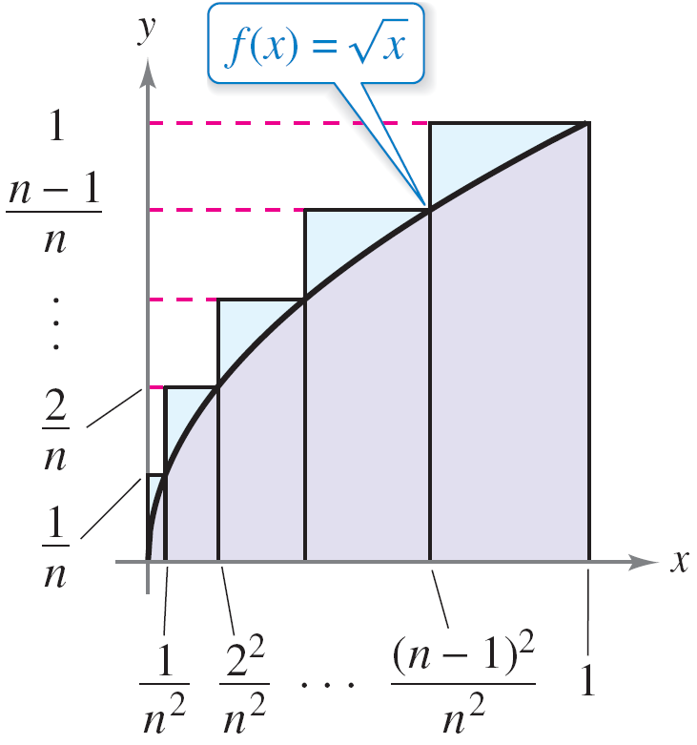
Example 1 – A Partition with Subintervals of Unequal Widths
Consider the region bounded by the graph of f (x) = and the x-axis for 0 ≤ x ≤ 1, as shown in Figure 4.18.
Evaluate the limit
where c_{i} is the right endpoint of the
partition given by c_{i} = i ²/n² and Δx_{i}
is the width of the i th interval.
The subintervals do not have
equal widths.
Figure 4.18

Slide 8
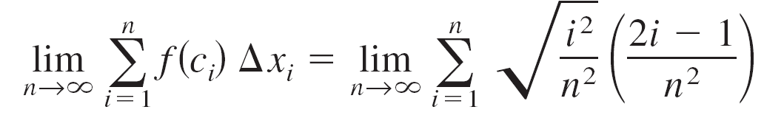
Example 1 – Solution
The width of the i th interval is
So, the limit is

Slide 9
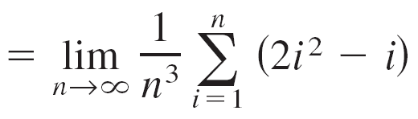
Example 1 – Solution
cont’d

Slide 10


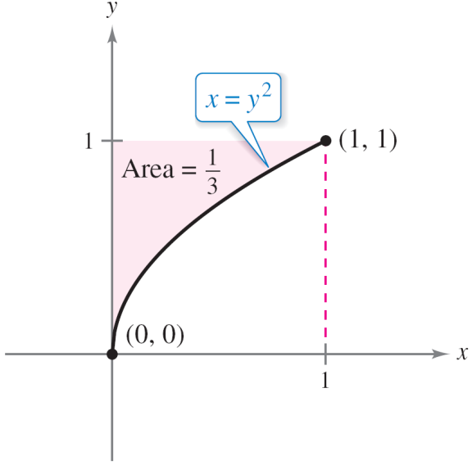

Riemann Sums
The region shown in Figure 4.19 has an area of Because the square bounded by 0 ≤ x ≤ 1 and 0 ≤ y ≤ 1 has an area of 1, you can conclude that the area of the region shown in Figure 4.18 has an area of
The subintervals do not have equal widths.
The area of the region bounded by the graph of x = y² and the y-axis for 0 ≤ y ≤ 1 is
Figure 4.18
Figure 4.19

Slide 11
Riemann Sums
This agrees with the limit found in Example 1, even though that example used a partition having subintervals of unequal widths.
The reason this particular partition gave the proper area is that as n increases, the width of the largest subinterval approaches zero.
This is a key feature of the development of definite integrals.

Slide 12
Riemann Sums
The limit of a sum was used to define the area of a region in the plane. Finding area by this means is only one of many applications involving the limit of a sum.
A similar approach can be used to determine quantities as diverse as arc lengths, average values, centroids, volumes, work, and surface areas.
The next definition is named after Georg Friedrich Bernhard Riemann (1826–1866). Although the definite integral had been defined and used long before Riemann’s time, he generalized the concept to cover a broader category of functions.

Slide 13
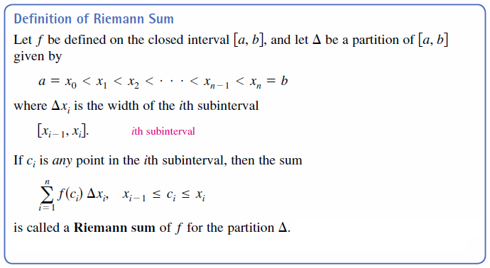
Riemann Sums
In the following definition of a Riemann sum, note that the function f has no restrictions other than being defined on the interval [a, b]. (The function f was assumed to be continuous and nonnegative because we were dealing with the area under a curve.)

Slide 14
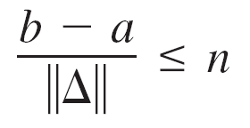
Riemann Sums
The width of the largest subinterval of a partition Δ is the norm of the partition and is denoted by || Δ ||. If every subinterval is of equal width, then the partition is regular and the norm is denoted by
For a general partition, the norm is related to the number of subintervals of [a, b] in the following way.
Regular partition
General partition

Slide 15

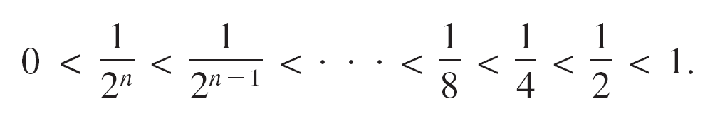
Riemann Sums
So, the number of subintervals in a partition approaches infinity as the norm of the partition approaches 0. That is, || Δ || → 0 implies that n →
The converse of this statement is not true. For example, let Δ_{n} be the partition of the interval [0, 1] given by

Slide 16
Riemann Sums
As shown in Figure 4.20, for any positive value of n, the
norm of the partition Δ_{n} is
So, letting n approach infinity does not force || Δ || to approach 0. In a regular partition, however, the statements
|| Δ || → 0 and n → are equivalent.
n → does not imply that || Δ || → 0.
Figure 4.20

Slide 17
Definite Integrals

Slide 18
Definite Integrals
To define the definite integral, consider the limit
To say that this limit exists means there exists a real number L such that for each ε > 0, there exists a δ > 0 such that for every partition with || Δ || ≤ δ , it follows that
regardless of the choice of c_{i} in the i th subinterval of each partition Δ.

Slide 19
Definite Integrals

Slide 20
Definite Integrals
It is not a coincidence that the notation for definite integrals is similar to that used for indefinite integrals.
It is important to see that definite integrals and indefinite integrals are different concepts. A definite integral is a number, whereas an indefinite integral is a family of functions.

Slide 21
Definite Integrals
Though Riemann sums were defined for functions with very few restrictions, a sufficient condition for a function f to be integrable on [a, b] is that it is continuous on [a, b].

Slide 22
Example 2 – Evaluating a Definite Integral as a Limit
Evaluate the definite integral.
Solution:
The function f (x) = 2x is integrable on the interval [–2, 1] because it is continuous on [–2, 1].
Moreover, the definition of integrability implies that any partition whose norm approaches 0 can be used to determine the limit.

Slide 23
Example 2 – Solution
cont’d
For computational convenience, define Δ by subdividing [–2, 1] into n subintervals of equal width
Choosing c_{i} as the right endpoint of each subinterval produces
c_{i} = a + i(Δx)

Slide 24
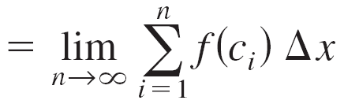
Example 2 – Solution
cont’d
So, the definite integral is

Slide 25
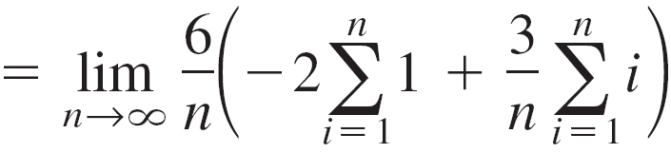
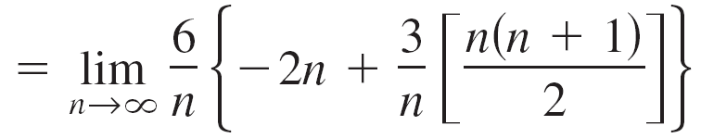
Example 2 – Solution
cont’d

Slide 26
Definite Integrals
Because the definite integral in
Example 2 is negative, it does
not represent the area of the
region shown in Figure 4.21.
Definite integrals can be positive,
negative, or zero.
Because the definite integral is negative, it
does not represent the area of the region.
Figure 4.21

Slide 27
Definite Integrals
For a definite integral to be
interpreted as an area, the
function f must be continuous
and nonnegative on [a, b],
as stated in the following
theorem.
You can use a definite integral to find the area of the region bounded by the graph of f, the x-axis, x = a, and x = b.
Figure 4.22

Slide 28
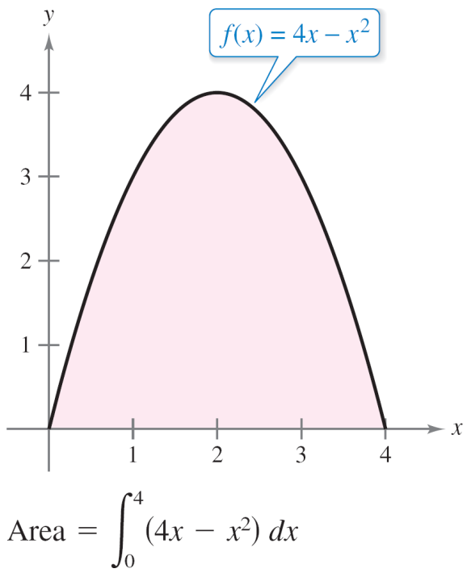
Definite Integrals
As an example of Theorem 4.5,
consider the region bounded by
the graph of
f (x) = 4x – x²
and the x-axis, as shown in
Figure 4.23.
Figure 4.23

Slide 29
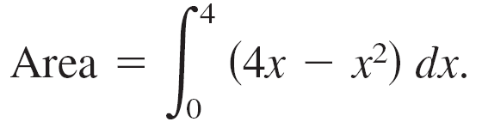
Definite Integrals
Because f is continuous and nonnegative on the closed interval [0, 4], the area of the region is
However, you can evaluate a definite integral in two ways—you can use the limit definition or you can check to see whether the definite integral represents the area of a common geometric region such as a rectangle, triangle, or semicircle.

Slide 30
Properties of Definite Integrals

Slide 31
Properties of Definite Integrals
The definition of the definite integral of f on the interval [a, b] specifies that a < b. Now, however, it is convenient to extend the definition to cover cases in which a = b or a > b.
Geometrically, the following two definitions seem reasonable. For instance, it makes sense to define the area of a region of zero width and finite height to be 0.

Slide 32
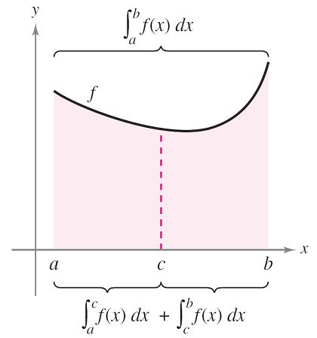
Properties of Definite Integrals
In Figure 4.25, the larger shaded region can be divided at
x = c into two subregions whose intersection is a line segment.
Because the line segment has zero
area, it follows that the area of the
larger region is equal to the sum of
the areas of the two smaller regions.
Figure 4.25

Slide 33
Properties of Definite Integrals
Because the definite integral is defined as the limit of a sum, it inherits the properties of summation.

Slide 34
Properties of Definite Integrals
Remark:
Property 2 of Theorem 4.7 can be extended to cover any finite number of functions.

Slide 35
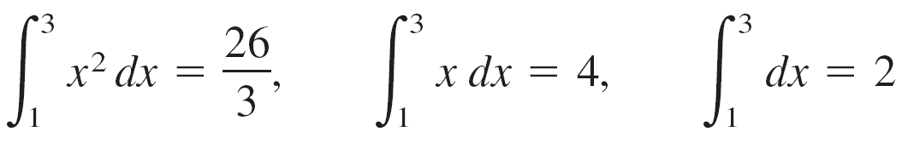
Example 6 – Evaluation of a Definite Integral
Evaluate using each of the following
values.
Algebraic Solution:

Slide 36
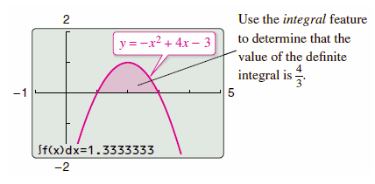
Example 6 – Solution
cont’d
Graphical Solution:

Slide 37
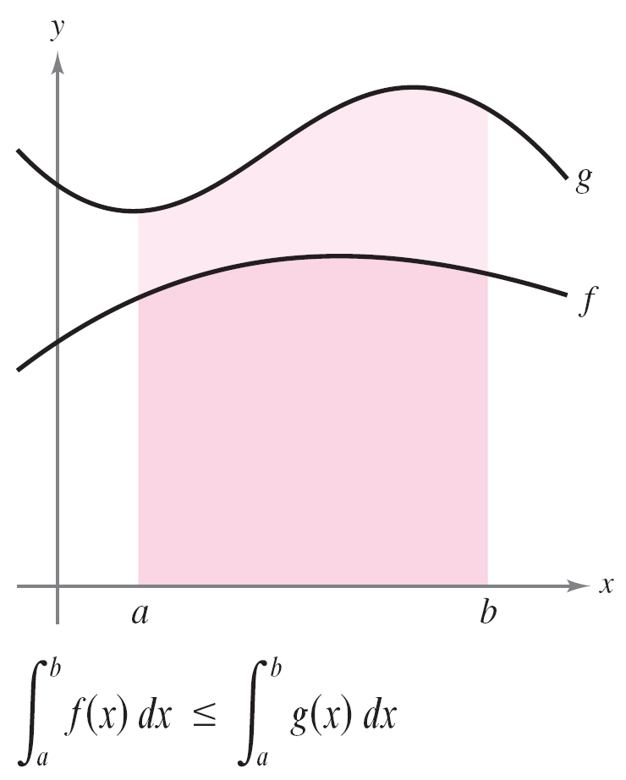
Properties of Definite Integrals
If f and g are continuous on the closed interval [a, b] and
0 ≤ f (x) ≤ g(x) for a ≤ x ≤ b, then the following properties are true.
First, the area of the region
bounded by the graph of f and
the x-axis (between a and b)
must be nonnegative.
Second, this area must be less
than or equal to the area of the
region bounded by the graph of g
and the x-axis (between a and b),
as shown in Figure 4.27.
Figure 4.27

Slide 38
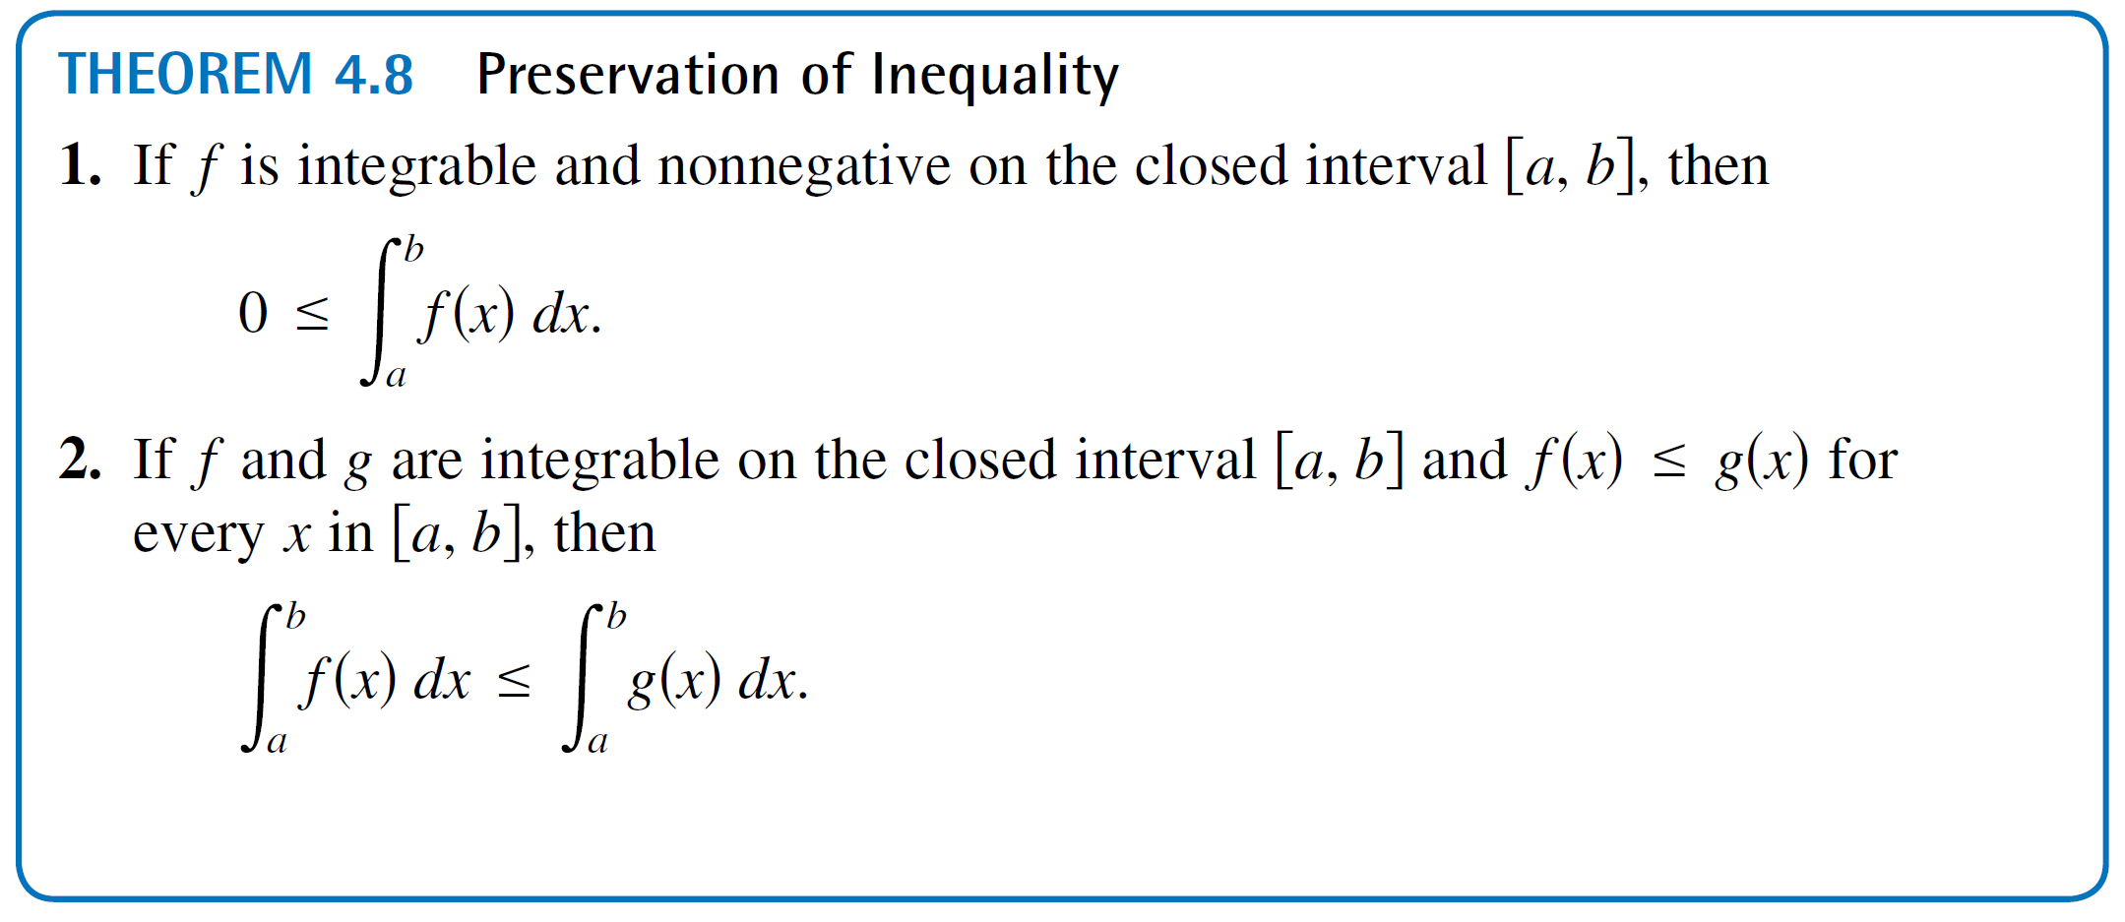
Properties of Definite Integrals
These two properties are generalized in Theorem 4.8.

Slide 39
The Trapezoidal Rule

Slide 40
The Trapezoidal Rule
Some elementary functions simply do not have antiderivatives that are elementary functions. When you need to evaluate a definite integral involving a function whose antiderivative cannot be found, you can use an approximation technique.
One way to approximate a definite
integral is to use n trapezoids,
as shown in Figure 4.28.
The area of the region can be approximated using four trapezoids.
Figure 4.28

Slide 41
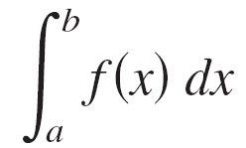
The Trapezoidal Rule
In the development of this method, assume that f is continuous and positive on the interval [a, b]. So, the definite integral
represents the area of the region bounded by the graph of f and the x-axis, from x = a to x = b. First, partition the interval [a, b] into n subintervals, each of width
Δx = (b – a)/n, such that
a = x₀ < x₁ < x₂ < . . . < x_{n} = b.

Slide 42
The Trapezoidal Rule
Then form a trapezoid for each subinterval. (See Figure 4.29.)
The area of the i th trapezoid is
This implies that the sum of the areas of
the n trapezoids is
Figure 4.29

Slide 43

The Trapezoidal Rule
Letting Δx = (b – a)/n, you can take the limit as n →
to obtain

Slide 44
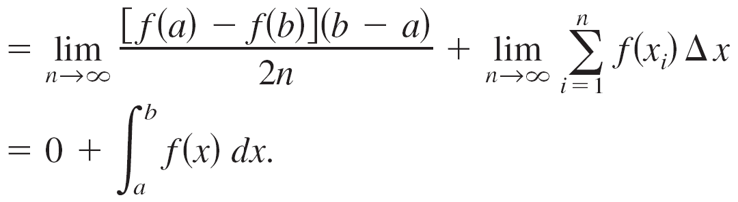
The Trapezoidal Rule
The result is summarized in the following theorem.

Slide 45
The Trapezoidal Rule
Notice in the next example that you can predict that the Trapezoidal Rule will underestimate the integral by looking at the concavity of the graph.
When the graph of a function is concave upward on a given interval, the Trapezoidal Rule will overestimate the value of the integral over the interval.
When the graph is concave downward, as in Example 8, the rule will underestimate the value of the integral.

Slide 46
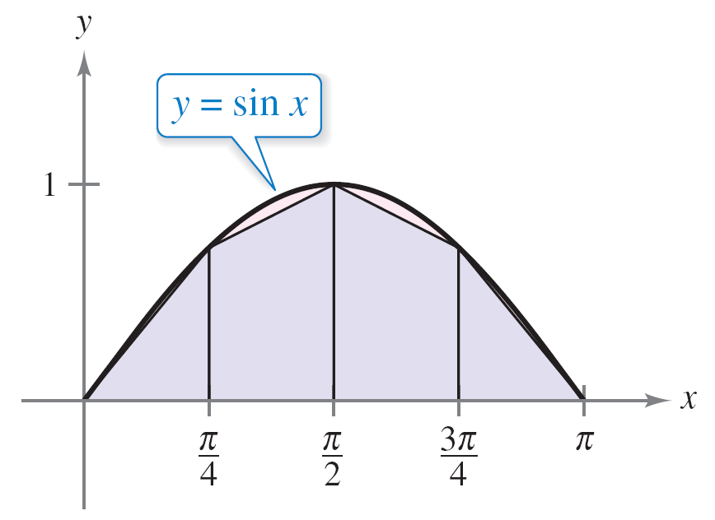
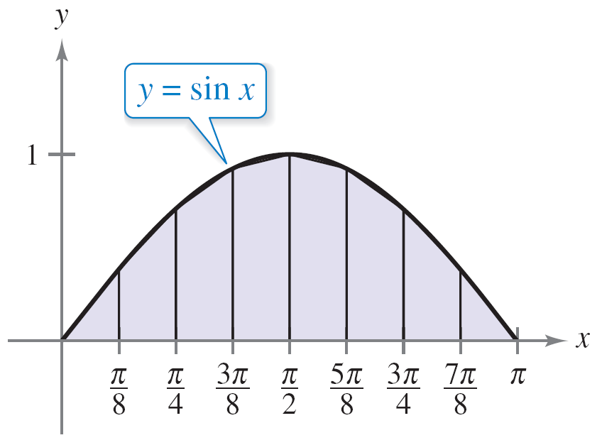
Example 8 – Approximation with the Trapezoidal Rule
Use the Trapezoidal Rule to approximate
Compare the results for n = 4 and n = 8, as shown in
Figure 4.30.
Four subintervals
Eight subintervals
Trapezoidal approximations
Figure 4.30

Slide 47
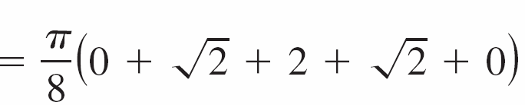
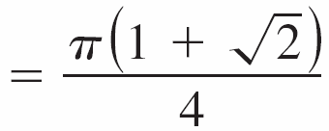
Example 8 – Solution
When n = 4, Δx = π /4, and you obtain

Slide 48
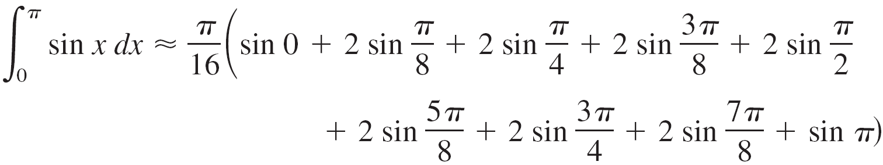
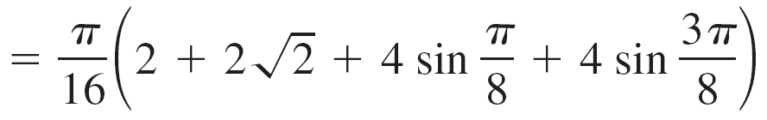
Example 8 – Solution
cont’d
When n = 8, Δx = π /8, and you obtain
For this particular integral, you can use a graphing utility to determine that the exact area of the region is 2.

Slide 49
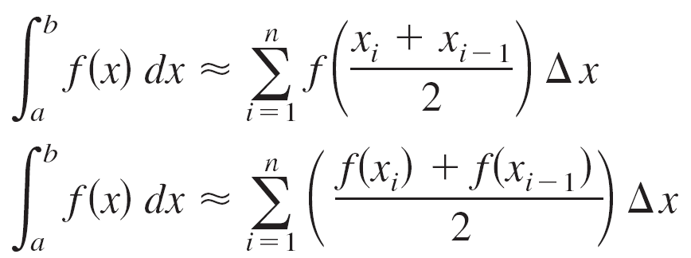
The Trapezoidal Rule
It is interesting to compare the Trapezoidal Rule with the Midpoint Rule.
For the Trapezoidal Rule, you average the function values at the endpoints of the subintervals, but for the Midpoint Rule, you take the function values of the subinterval midpoints.
Midpoint Rule
Trapezoidal Rule

Slide 50
Error Analysis

Slide 51
Error Analysis
When you use the Trapezoidal Rule, it is important to know how accurate you can expect the approximation to be.
The next theorem, gives the formula for estimating the error involved in the use of the Trapezoidal Rule.
In general, when using an approximation, you can think of the error E as the difference between and the approximation.

Slide 52

Error Analysis
Theorem 4.10 states that the error generated by the Trapezoidal Rule has an upper bound dependent on the extreme value of in the interval [a, b].
Furthermore, this error can be made arbitrarily small by increasing n, provided that f ″ is continuous and therefore bounded in [a, b].

Slide 53



Example 9 – The Approximate Error in the Trapezoidal Rule
Determine a value of n such that the Trapezoidal Rule will approximate the value of with an error that is less than or equal to 0.01.
Solution:
Begin by letting and finding the second derivative of f.
and
The maximum value of | f ″ (x) | on the interval [0, 1]
is | f ″ (0) | = 1.

Slide 54
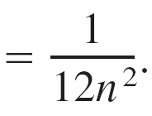

Example 9 – Solution
cont’d
So, by Theorem 4.10, you can write
To obtain an error E that is less than 0.01, you must choose n such that 1/(12n²) ≤ 1/100.
100 ≤ 12n² n ≥ ≈ 2.89

Slide 55
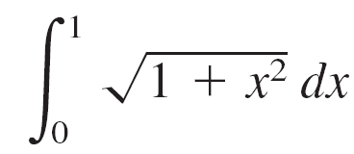
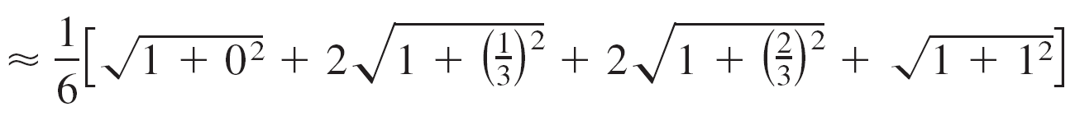

Example 9 – Solution
cont’d
So, you can choose n = 3 (because n
must be greater than or equal to 2.89)
and apply the Trapezoidal Rule, as
shown in Figure 4.31, to obtain
Figure 4.31

Slide 56
Example 9 – Solution
cont’d
So, by adding and subtracting the error from this estimate,
you know that

