Slide 1

3
Applications of
Differentiation
Copyright © Cengage Learning. All rights reserved.

Slide 2

3.7
Differentials
Copyright © Cengage Learning. All rights reserved.

Slide 3
Objectives
Understand the concept of a tangent line approximation.
Compare the value of the differential, dy, with the actual change in y, Δy.
Estimate a propagated error using a differential.
Find the differential of a function using differentiation formulas.

Slide 4
Tangent Line Approximations

Slide 5
Tangent Line Approximations
Newton’s Method is an example of the use of a tangent line to approximate the graph of a function. In this section, you will study other situations in which the graph of a function can be approximated by a straight line.
To begin, consider a function f that is differentiable at c. The equation for the tangent line at the point (c, f (c)) is
and is called the tangent line approximation (or linear approximation) of f at c.

Slide 6
Tangent Line Approximations
Because c is a constant, y is a linear function of x. Moreover, by restricting the values of x to those sufficiently close to c, the values of y can be used as approximations (to any desired degree of accuracy) of the values of the function f.
In other words, as x approaches c, the limit of y is f (c).

Slide 7
Example 1 – Using a Tangent Line Approximation
Find the tangent line approximation of f (x) = 1 + sin x
at the point (0, 1). Then use a table to compare the
y-values of the linear function with those of f (x) on an open interval containing x = 0.
Solution:
The derivative of f is f ′(x) = cos x. So, the equation of the tangent line to the graph of f at the point (0, 1) is
y = f (0) + f ′(0)(x – 0)
y = 1 + (1)(x – 0)
y = 1 + x.
Tangent line approximation

Slide 8
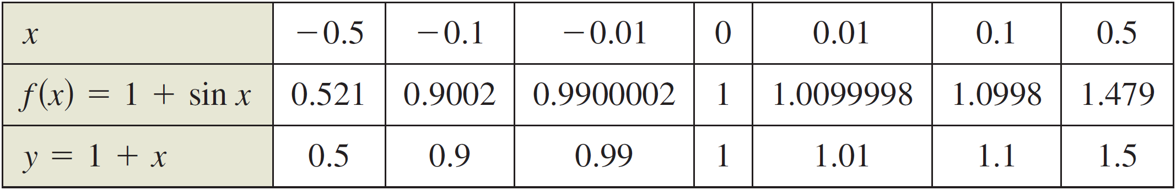
Example 1 – Solution
cont’d
The table compares the values of y given by this linear approximation with the values of f (x) near x = 0. Notice
that the closer x is to 0, the better the approximation.

Slide 9
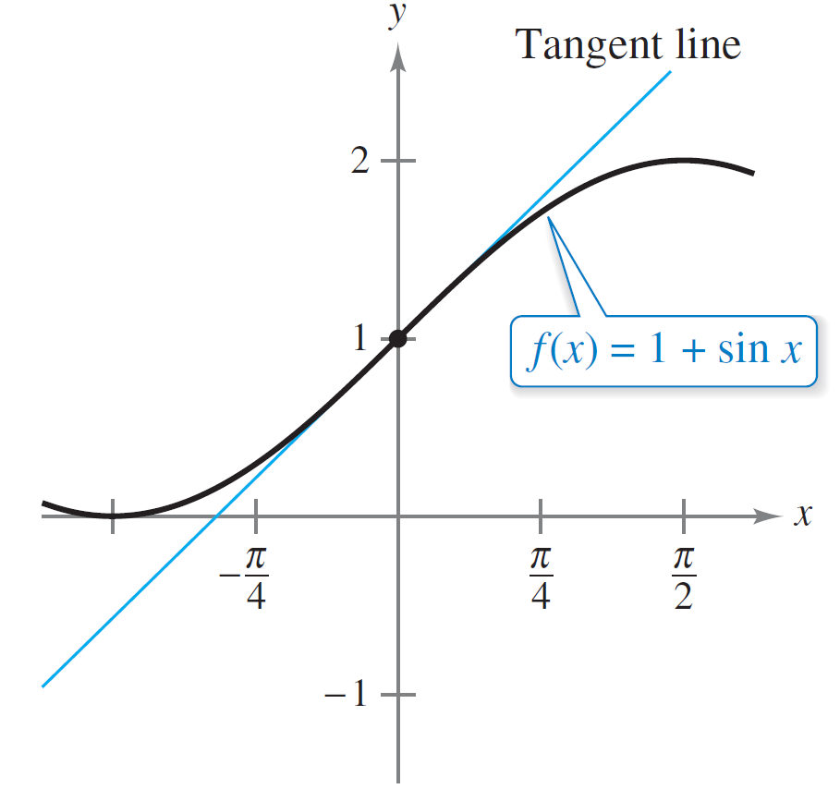
Example 1 – Solution
cont’d
This conclusion is reinforced by the graph shown in Figure 3.53.
The tangent line approximation of f at the point (0, 1)
Figure 3.53

Slide 10
Differentials

Slide 11
Differentials
When the tangent line to the graph of f at the point (c, f (c))
y = f (c) + f ′(c)(x – c)
is used as an approximation of
the graph of f, the quantity
x – c is called the change in x,
and is denoted by Δx, as
shown in Figure 3.54.
Tangent line at (c, f (c))
When Δx is small, Δy = f (c + Δx) – f (c)
is approximated by f ′(c)Δx.
Figure 3.54

Slide 12
Differentials
When Δx is small, the change in y (denoted by Δy) can be approximated as shown.
Δy = f (c + Δx) – f (c)
≈ f ′(c)Δx
For such an approximation, the quantity Δx is traditionally denoted by dx, and is called the differential of x.
The expression f ′(x)dx is denoted by dy, and is called the differential of y.
Actual change in y
Approximate change in y

Slide 13
Differentials
In many types of applications, the differential of y can be used as an approximation of the change in y. That is,
Δy ≈ dy or Δy ≈ f ′(x)dx.

Slide 14
Example 2 – Comparing Δy and dy
Let y = x². Find dy when x = 1 and dx = 0.01. Compare this value with Δy for x = 1 and Δx = 0.01.
Solution:
Because y = f (x) = x², you have f ′(x) = 2x, and the differential dy is given by
dy = f ′(x)dx
= f ′(1)(0.01)
= (2)(0.01)
= 0.02.
Differential of y

Slide 15
Example 2 – Solution
cont’d
Now, using Δx = 0.01, the change in y is
Δy = f (x + Δx) – f (x)
= f (1.01) – f (1)
= (1.01)² – (1)²
= 0.0201.

Slide 16
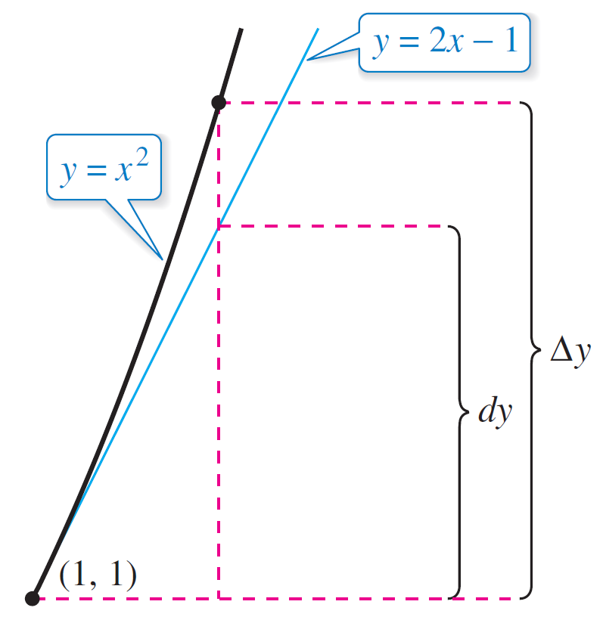
Example 2 – Solution
cont’d
Figure 3.55 shows the geometric comparison of dy and Δy.
Try comparing other values of
dy and Δy. You will see that the
values become closer to each
other as dx (or Δx) approaches
0.
The change in y, Δy, is approximated by the
differential of y, dy.
Figure 3.55

Slide 17
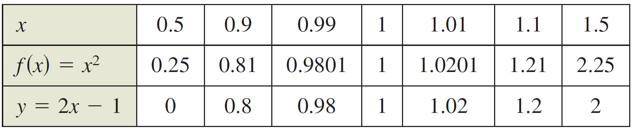
Differentials
In Example 2, the tangent line to the graph of f (x) = x² at
x = 1 is
y = 2x – 1.
For x-values near 1, this line is close to the graph of f, as shown in Figure 3.55 and in the table.
Tangent line to the graph of f
at x = 1.

Slide 18
Error Propagation

Slide 19
Error Propagation
Physicists and engineers tend to make liberal use of the approximation of Δy by dy.
One way this occurs in practice is in the estimation of errors propagated by physical measuring devices.
For example, if you let x represent the measured value of a variable and let x + Δx represent the exact value, then Δx is the error in measurement.

Slide 20
Error Propagation
Finally, if the measured value x is used to compute another value f (x), then the difference between f (x + Δx) and f (x) is the propagated error.

Slide 21
Example 3 – Estimation of Error
The measured radius of a ball bearing is 0.7 inch, as shown in figure. The measurement is correct to within 0.01 inch. Estimate the propagated error in the volume V of the ball bearing.
Ball bearing with measured radius that is
correct to within 0.01 inch.

Slide 22
Example 3 – Solution
The formula for the volume of a sphere is
where r is the radius of the sphere.
So, you can write
r = 0.7
and
– 0.01 ≤ Δr ≤ 0.01.
Measured radius
Possible error

Slide 23
Example 3 – Solution
cont’d
To approximate the propagated error in the volume, differentiate V to obtain dV/dr = 4πr² and write
ΔV ≈ dV
= 4πr² dr
= 4π(0.7)² (±0.01)
≈ ±0.06158 cubic inch.
So, the volume has a propagated error of about 0.06 cubic inch.
Approximate ΔV by dV.
Substitute for r and dr.

Slide 24
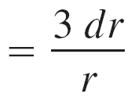
Error Propagation
Would you say that the propagated error in Example 3 is large or small? The answer is best given in relative terms
by comparing dV with V. The ratio
is called the relative error. The corresponding percent error is approximately 4.29%.
Ratio of dV to V
Simplify.
Substitute for dr and r.

Slide 25
Calculating Differentials

Slide 26
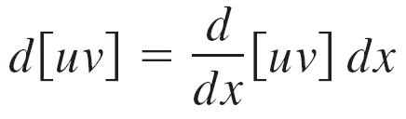
Calculating Differentials
Each of the differentiation rules that we have studied can be written in differential form.
For example, let u and v be differentiable functions of x. By the definition of differentials, you have
du = u ′dx and dv = v ′dx.
So, you can write the differential form of the Product Rule as shown below.
= [uv ′ + vu ′] dx
Differential of uv
Product Rule

Slide 27
Calculating Differentials
= uv ′ dx + vu ′ dx
= u dv + v du

Slide 28
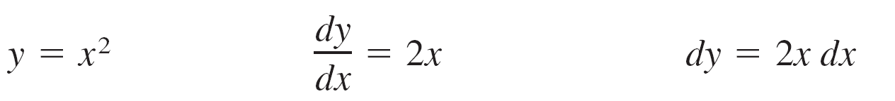
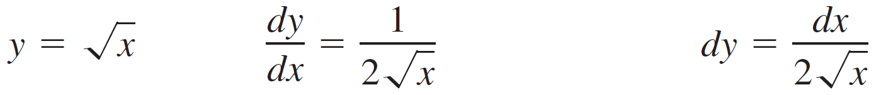
Example 4 – Finding Differentials
Function Derivative Differential
a.
b.
c.
d.
e.

Slide 29
Calculating Differentials
The notation in Example 4 is called the Leibniz notation for derivatives and differentials, named after the German mathematician Gottfried Wilhelm Leibniz (1646–1716).
The beauty of this notation is that it provides an easy way to remember several important calculus formulas by making it seem as though the formulas were derived from algebraic manipulations of differentials.

Slide 30
Calculating Differentials
For instance, in Leibniz notation, the Chain Rule
would appear to be true because the du’s divide out.
Even though this reasoning is incorrect, the notation does help one remember the Chain Rule.

Slide 31
Calculating Differentials
Differentials can be used to approximate function values. To do this for the function given by y = f (x), use the formula
which is derived from the approximation
Δy = f (x + Δx) – f (x) ≈ dy.
The key to using this formula is to choose a value for x that makes the calculations easier. (This formula is equivalent to the tangent line approximation.)

