Slide 1

1
Limits and
Their Properties
Copyright © Cengage Learning. All rights reserved.

Slide 2

1.6
Limits at Infinity
Copyright © Cengage Learning. All rights reserved.

Slide 3
Objectives
Determine (finite) limits at infinity.
Determine the horizontal asymptotes, if any, of
the graph of a function.
Determine infinite limits at infinity.

Slide 4
Limits at Infinity

Slide 5
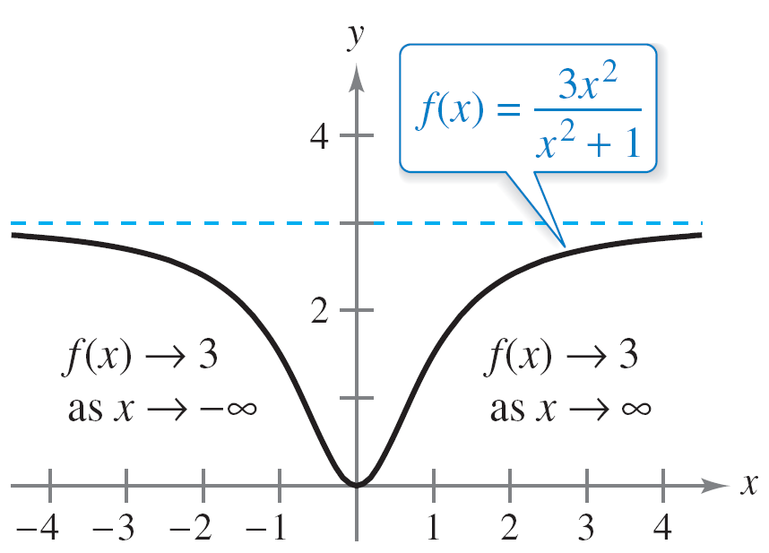
Limits at Infinity
This section discusses the “end behavior” of a function on an infinite interval. Consider the graph of
as shown in Figure 1.46.
The limit of f (x) as x approaches or is 3.
Figure 1.46

Slide 6
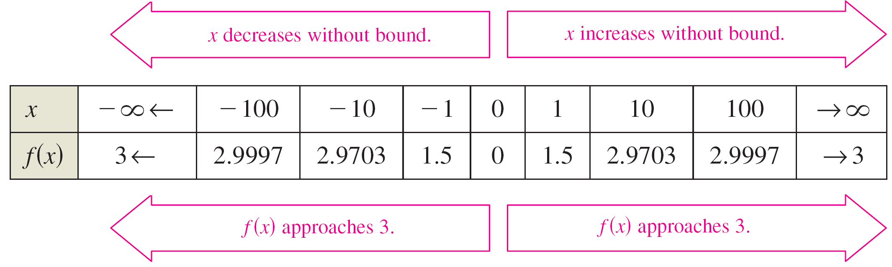
Limits at Infinity
Graphically, you can see that the values of f (x) appear to approach 3 as x increases without bound or decreases without bound. You can come to the same conclusions numerically, as shown in the table.
The table suggests that the value of f (x) approaches 3 as x increases without bound (x → ).

Slide 7
Limits at Infinity
Similarly, f (x) approaches 3 as x decreases without bound
(x → ).
These limits at infinity are denoted by
and
To say that a statement is true as x increases without bound means that for some (large) real number M, the statement is true for all x in the interval {x: x > M }.
Limit at negative infinity
Limit at positive infinity

Slide 8
Limits at Infinity
The following definition uses this concept.

Slide 9
Limits at Infinity
The definition of a limit at infinity is shown in Figure 1.47. In this figure, note that for a given positive number ε, there exists a positive number M such that, for x > M, the graph of f will lie between the horizontal lines
y = L + ε and y = L – ε.
f (x) is within ε units of L as x → .
Figure 1.47

Slide 10
Horizontal Asymptotes

Slide 11
Horizontal Asymptotes
In Figure 1.47, the graph of f approaches the line y = L as x increases without bound.
f (x) is within ε units of L as x →
Figure 1.47

Slide 12
Horizontal Asymptotes
The line y = L is called a horizontal asymptote of the graph of f.
Note that from this definition, it follows that the graph of a function of x can have at most two horizontal asymptotes—one to the right and one to the left.
Limits at infinity have many of the same properties of limits that we have discussed.

Slide 13
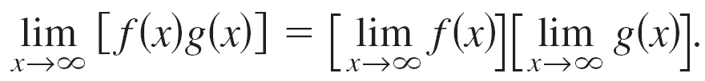
Horizontal Asymptotes
For example, if and both exist, then
and
Similar properties hold for limits at

Slide 14
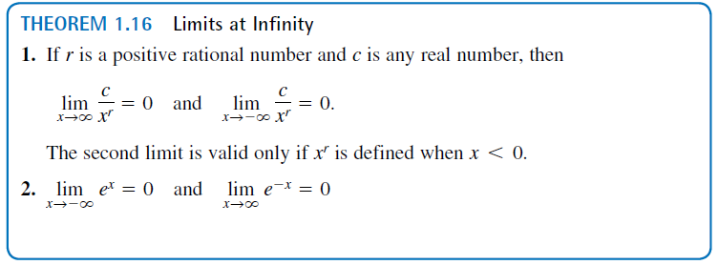
Horizontal Asymptotes
When evaluating limits at infinity, the following theorem is helpful.

Slide 15
Example 1 – Evaluating a Limit at Infinity
Find the limit.
a. b.
Solution:
a.
= 5 – 0
= 5
Property of limits
Apply Theorem 1.16.

Slide 16
Example 1 – Solution
cont’d
b.
= 3(0)
= 0
Rewrite function.
Property of limits
Apply Theorem 1.16.

Slide 17
Horizontal Asymptotes
The guidelines for finding limits at infinity of rational functions seem reasonable when you consider that for large values of x, the highest-power term of the rational function is the most “influential” in determining the limit.

Slide 18
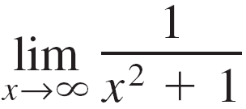
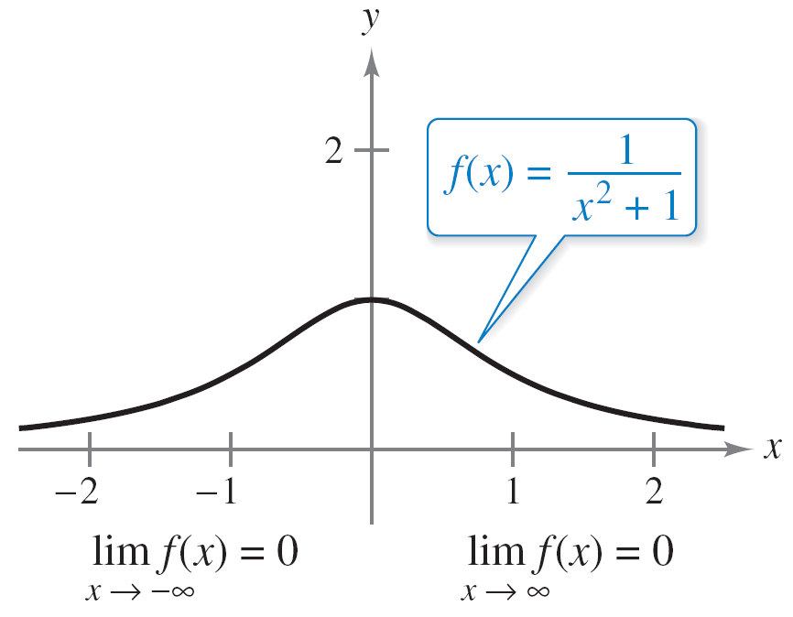
Horizontal Asymptotes
For instance,
is 0 because the denominator overpowers the numerator as x increases or decreases without bound, as shown in Figure 1.49.
f has a horizontal asymptote at y = 0.
Figure 1.49

Slide 19
Horizontal Asymptotes
The function shown in Figure 1.49 is a special case of a type of curve studied by the Italian mathematician Maria Gaetana Agnesi.
The general form of this function is
and, through a mistranslation of the Italian word vertéré, the curve has come to be known as the Witch of Agnesi.
Agnesi’s work with this curve first appeared in a comprehensive text on calculus.
Witch of Agnesi

Slide 20
Horizontal Asymptotes
In Figure 1.49, you can see that the function
approaches the same horizontal asymptote to the right and to the left. This is always true of rational functions.
Functions that are not rational, however, may approach different horizontal asymptotes to the right and to the left.
A common example of such a function is the logistic function.

Slide 21
Infinite Limits at Infinity

Slide 22
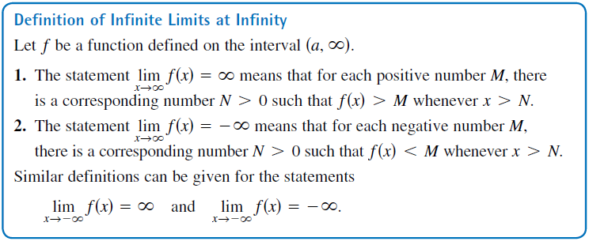
Infinite Limits at Infinity
Many functions do not approach a finite limit as x increases (or decreases) without bound. For instance, no polynomial function has a finite limit at infinity. You can use the
definition below to describe the behavior of polynomial and other functions at infinity.

Slide 23

Example 7 – Finding Infinite Limits at Infinity
Find each limit. a. b.
Solution:
a. As x increases without bound, x³ also increases without
bound. So, you can write
b. As x decreases without bound, x³ also decreases without
bound. So, you can write

Slide 24
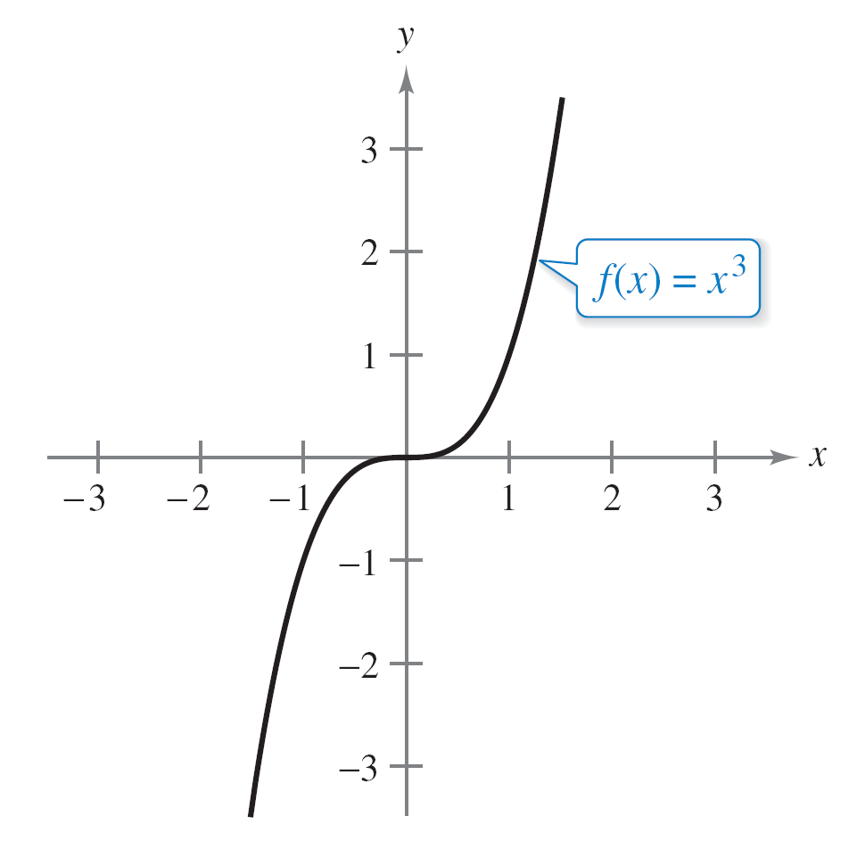
Example 7 – Solution
cont’d
The graph of f (x) = x³ in Figure 1.54 illustrates these two results. These results agree with the Leading Coefficient Test for polynomial functions.
Figure 1.54

