Slide 1

1
Limits and
Their Properties
Copyright © Cengage Learning. All rights reserved.

Slide 2

1.5
Infinite Limits
Copyright © Cengage Learning. All rights reserved.

Slide 3
Objectives
Determine infinite limits from the left and from
the right.
Find and sketch the vertical asymptotes of the
graph of a function.

Slide 4
Infinite Limits

Slide 5
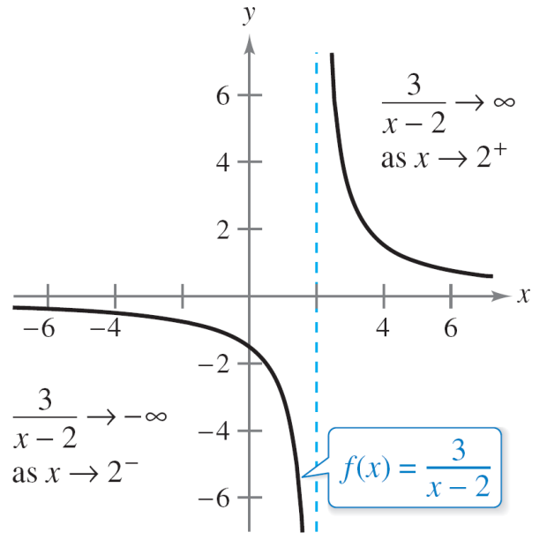
Infinite Limits
Consider the function f (x) = 3/(x – 2).
From Figure 1.39 and the table, you can see that f (x) decreases without bound as x approaches 2 from the left, and f (x) increases without bound as x approaches 2 from the right.
f (x) increases and decreases without bound as x approaches 2.
Figure 1.39

Slide 6
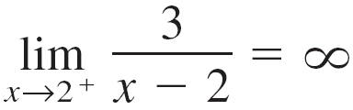
Infinite Limits
This behavior is denoted as
and
A limit in which f (x) increases or decreases without bound as x approaches c is called an infinite limit.
f (x) decreases without bound as
x approaches 2 from the left.
f (x) increases without bound as
x approaches 2 from the right.

Slide 7
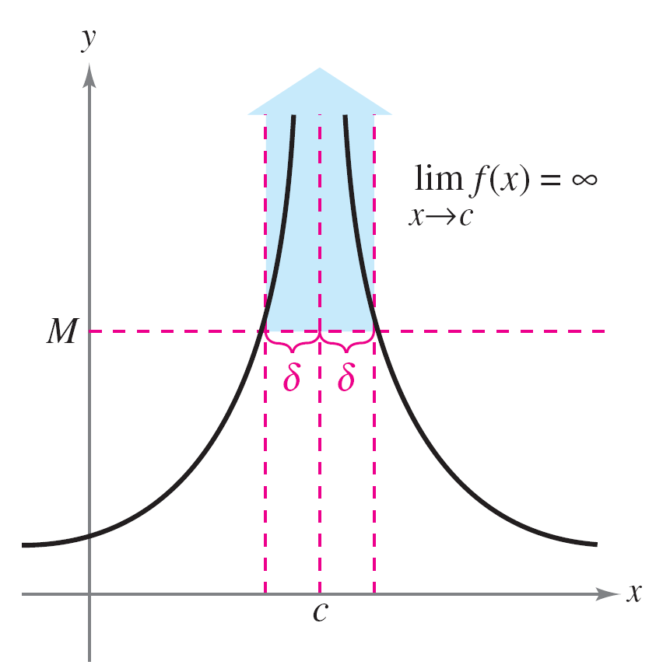

Infinite Limits
Be sure you see that the equal sign in the statement
lim f (x) = does not mean that the limit exists! On the contrary, it tells you how the limit fails to exist by denoting the unbounded behavior of f (x) as x approaches c.
Infinite limits
Figure 1.40

Slide 8
Example 1 – Determining Infinite Limits from a Graph
Determine the limit of each function shown in Figure 1.41 as x approaches 1 from the left and from the right.
(a)
(b)
Each graph has an asymptote at x = 1.
Figure 1.41

Slide 9
Example 1 – Solution
Algebraic Solution
a. When x approaches 1 from the left or the right, (x – 1)² is
a small positive number.
Thus, the quotient 1/(x – 1)² is a large positive number,
and f (x) approaches infinity from each side of x = 1.
So, you can conclude that
Figure 1.41(a) supports this conclusion.
Limit from each side is infinity.

Slide 10
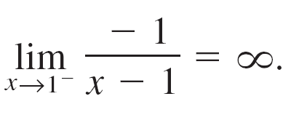
Example 1 – Solution
cont’d
b. When x approaches 1 from the left, x – 1 is a small
negative number.
Thus, the quotient –1/(x – 1) is a large positive number,
and f (x) approaches infinity from left side of x = 1.
So, you can conclude that
Limit from the left side is infinity.

Slide 11
Example 1 – Solution
cont’d
When x approaches 1 from the right, x – 1 is a small
positive number.
Thus, the quotient –1/(x – 1) is a large negative number,
and f (x) approaches negative infinity from the right side
of x = 1.
So, you can conclude that
Figure 1.41(b) supports this conclusion.
Limit from the right side is negative infinity.

Slide 12
Example 1 – Solution
cont’d
Numerical Solution
Use a graphing utility to create a table of values to analyze the limit of each function as x approaches 1 from the left and from the right.
a.
So, you can conclude that

Slide 13
Example 1 – Solution
cont’d
b.
So, you can conclude that

Slide 14
Vertical Asymptotes

Slide 15
Vertical Asymptotes
If it were possible to extend the graphs in Figure 1.41 toward positive and negative infinity, then you would see that each graph becomes arbitrarily close to the vertical line
x = 1.
This line is a vertical asymptote of the graph of f.

Slide 16
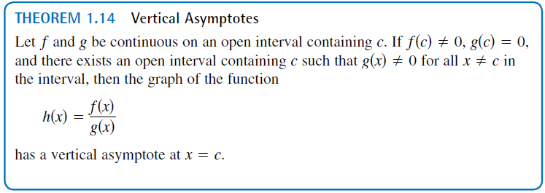
Vertical Asymptotes
In Example 1, note that each of the functions is a quotient and that the vertical asymptote occurs at a number at which the denominator is 0 (and the numerator is not 0).
The below given theorem generalizes this observation.

Slide 17
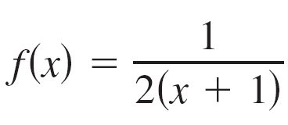
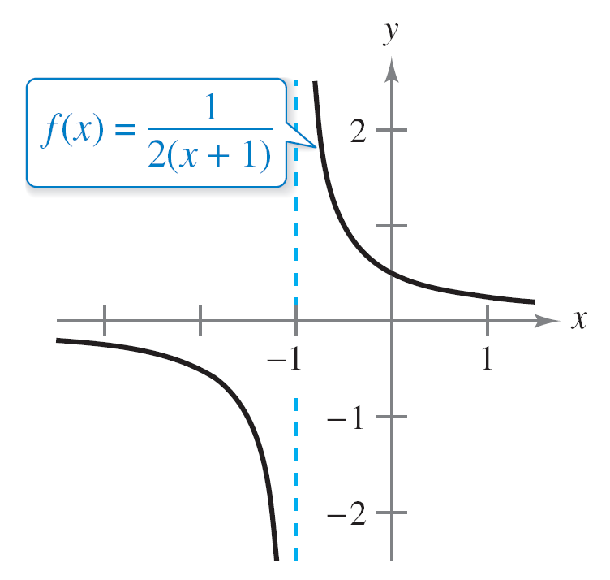
Example 2 – Finding Vertical Asymptotes
a. When x = –1, the denominator of
is 0 and the numerator is not 0.
So, by Theorem 1.14, you
can conclude that x = –1 is a
vertical asymptote, as shown
in Figure 1.42(a).
Functions with vertical asymptotes
Figure 1.42(a)

Slide 18
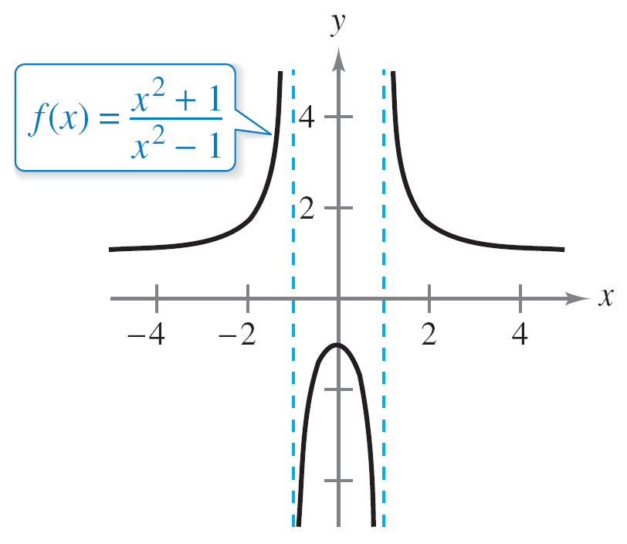
Example 2 – Finding Vertical Asymptotes
cont’d
b. By factoring the denominator as
you can see that the denominator is 0 at x = –1 and
x = 1.
Also, because the numerator
is not 0 at these two points, you
can apply Theorem 1.14 to
conclude that the graph of f has
two vertical asymptotes, as
shown in Figure 1.42(b).
Functions with vertical asymptotes
Figure 1.42(b)

Slide 19
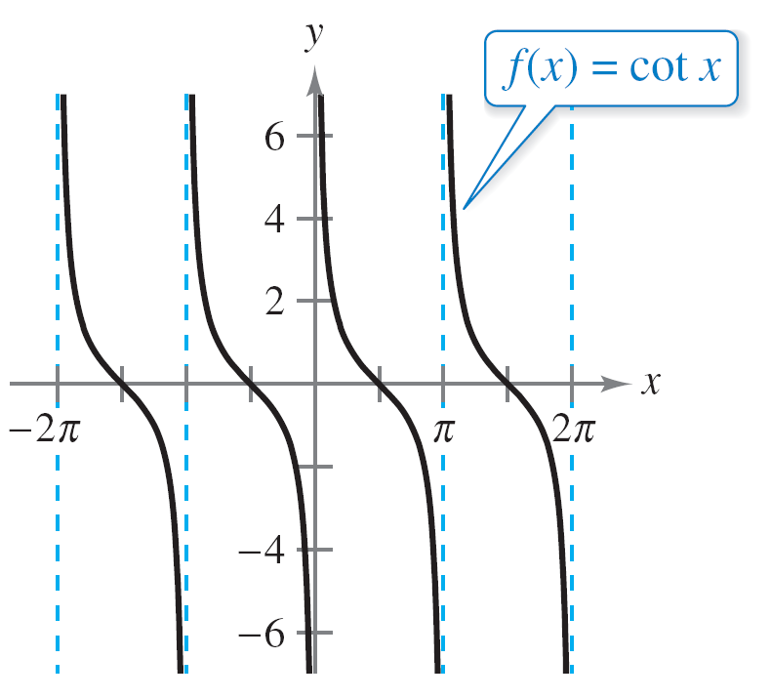
Example 2 – Finding Vertical Asymptotes
cont’d
c. By writing the cotangent function in the form
f (x) = cot x =
you can apply Theorem 1.14
to conclude that vertical
asymptotes occur at all values
of x such that sin x = 0 and
cos x ≠ 0, as shown in
Figure 1.42(c).
Functions with vertical asymptotes
Figure 1.42(c)

Slide 20
Example 2 – Finding Vertical Asymptotes
cont’d
So, the graph of this function has infinitely many vertical
asymptotes. These asymptotes occur at x = nπ,
where n is an integer.

Slide 21
Vertical Asymptotes
Theorem 1.14 requires that the value of the numerator at
x = c be nonzero.
When both the numerator and the denominator are 0 at
x = c, you obtain the indeterminate form 0/ 0, and you cannot determine the limit behavior at x = c without further investigation.

Slide 22
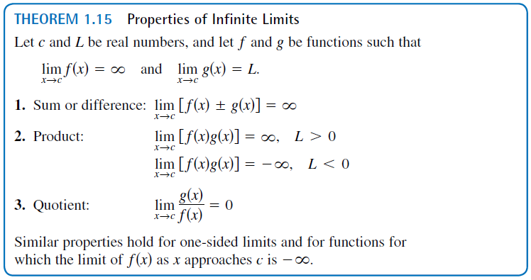
Vertical Asymptotes

